Slide 1
HAITI
Building a School - Building a Future

Slide 2
Touching down at Port au Prince Airport. Very pretty from the air.

Slide 3
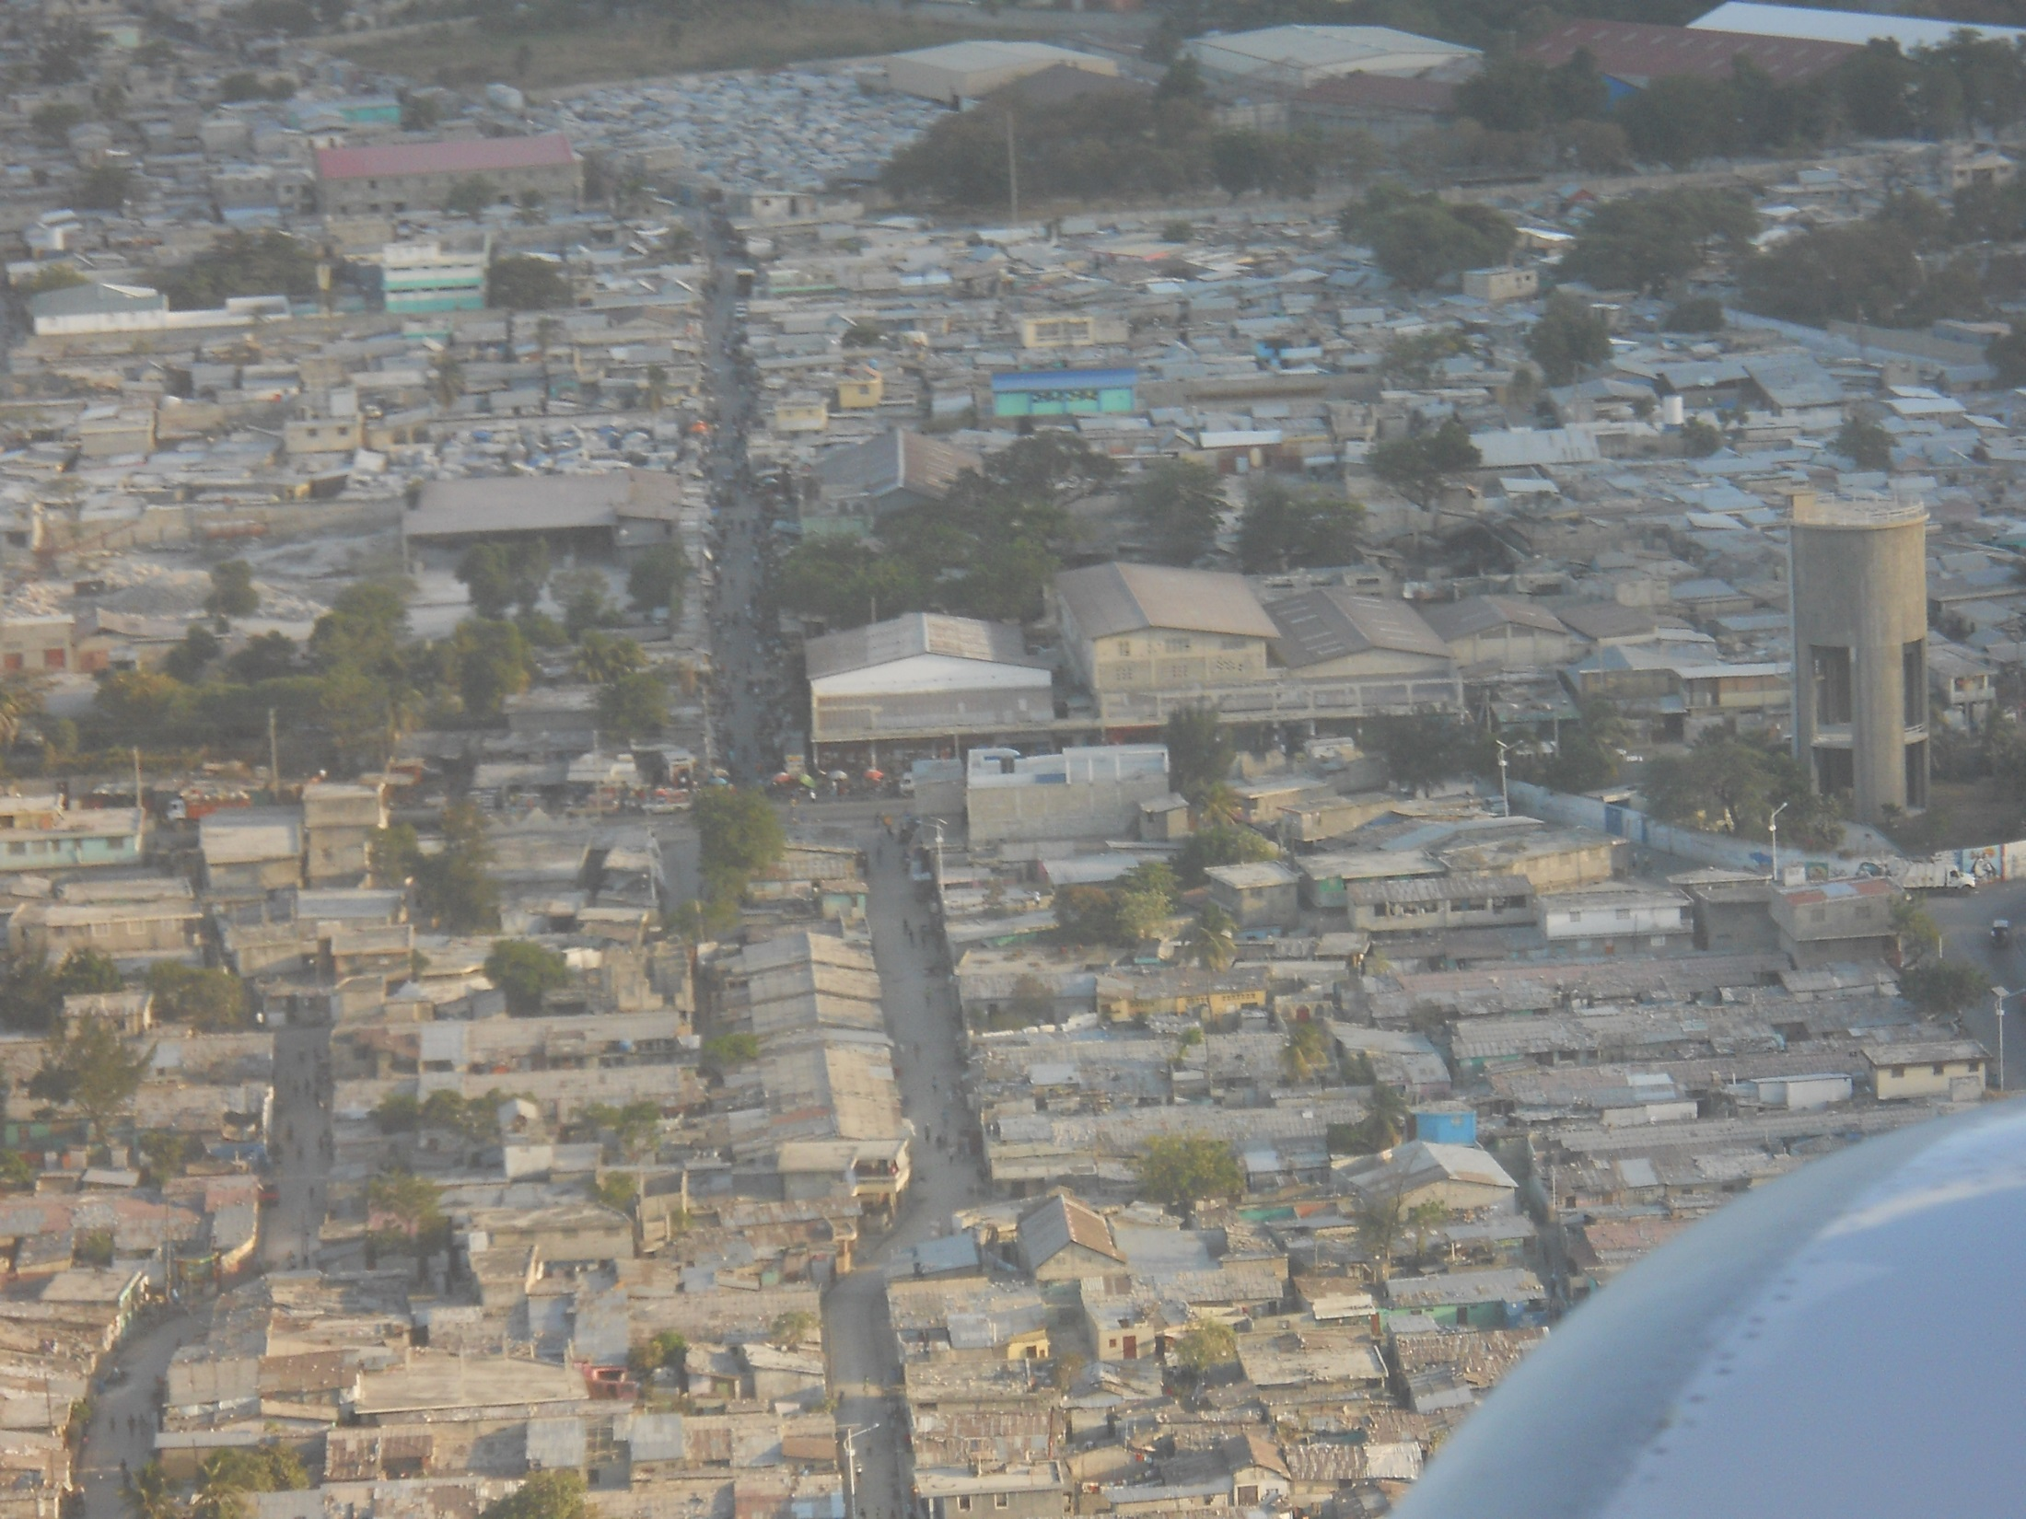

Slide 4
We stayed at the Blue Moon Hotel in Jacmel, Haiti. Jacmel is on the southern shore, about 40 miles from Port au Prince. It took our driver 2-1/2 hours to get us there from the airport. The roads – mostly unpaved - wind around the mountains.

Slide 5
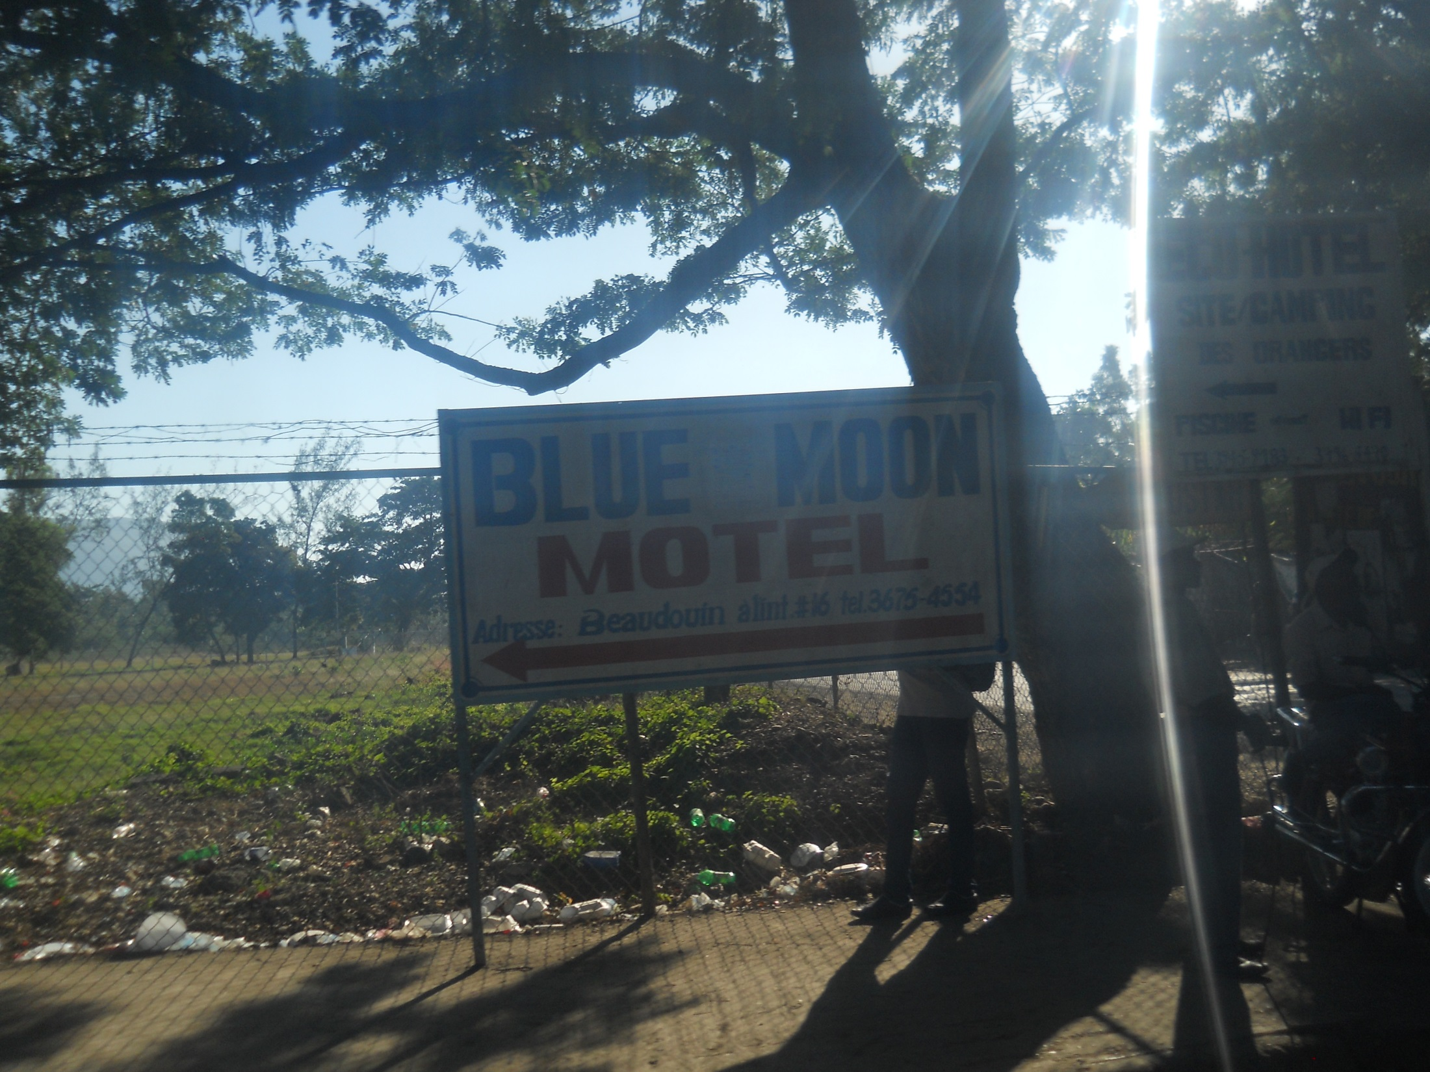

Slide 6
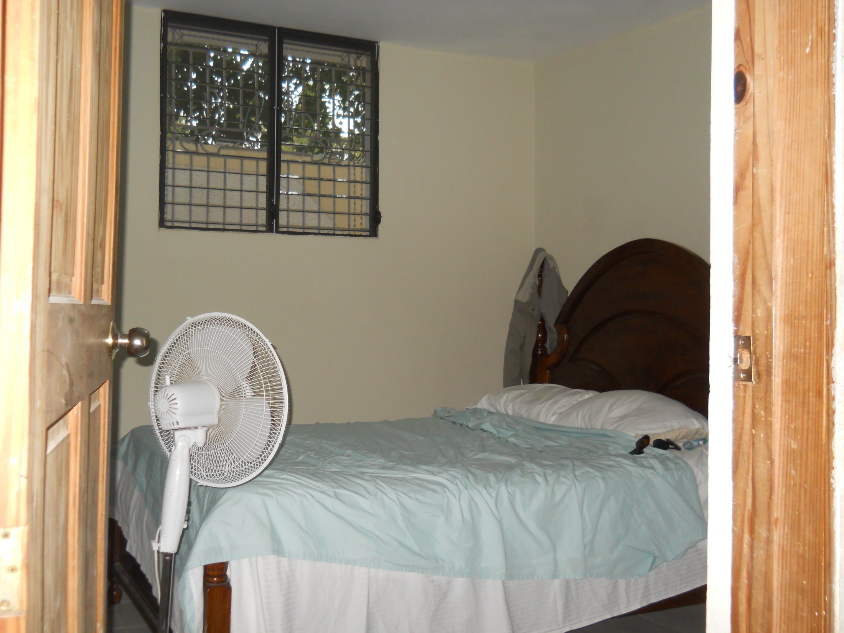

Slide 7
Note the repairs in the concrete, and the cracks that have not been repaired. At the time we were there, it had been 4 years since the devastating earthquake.

Slide 8
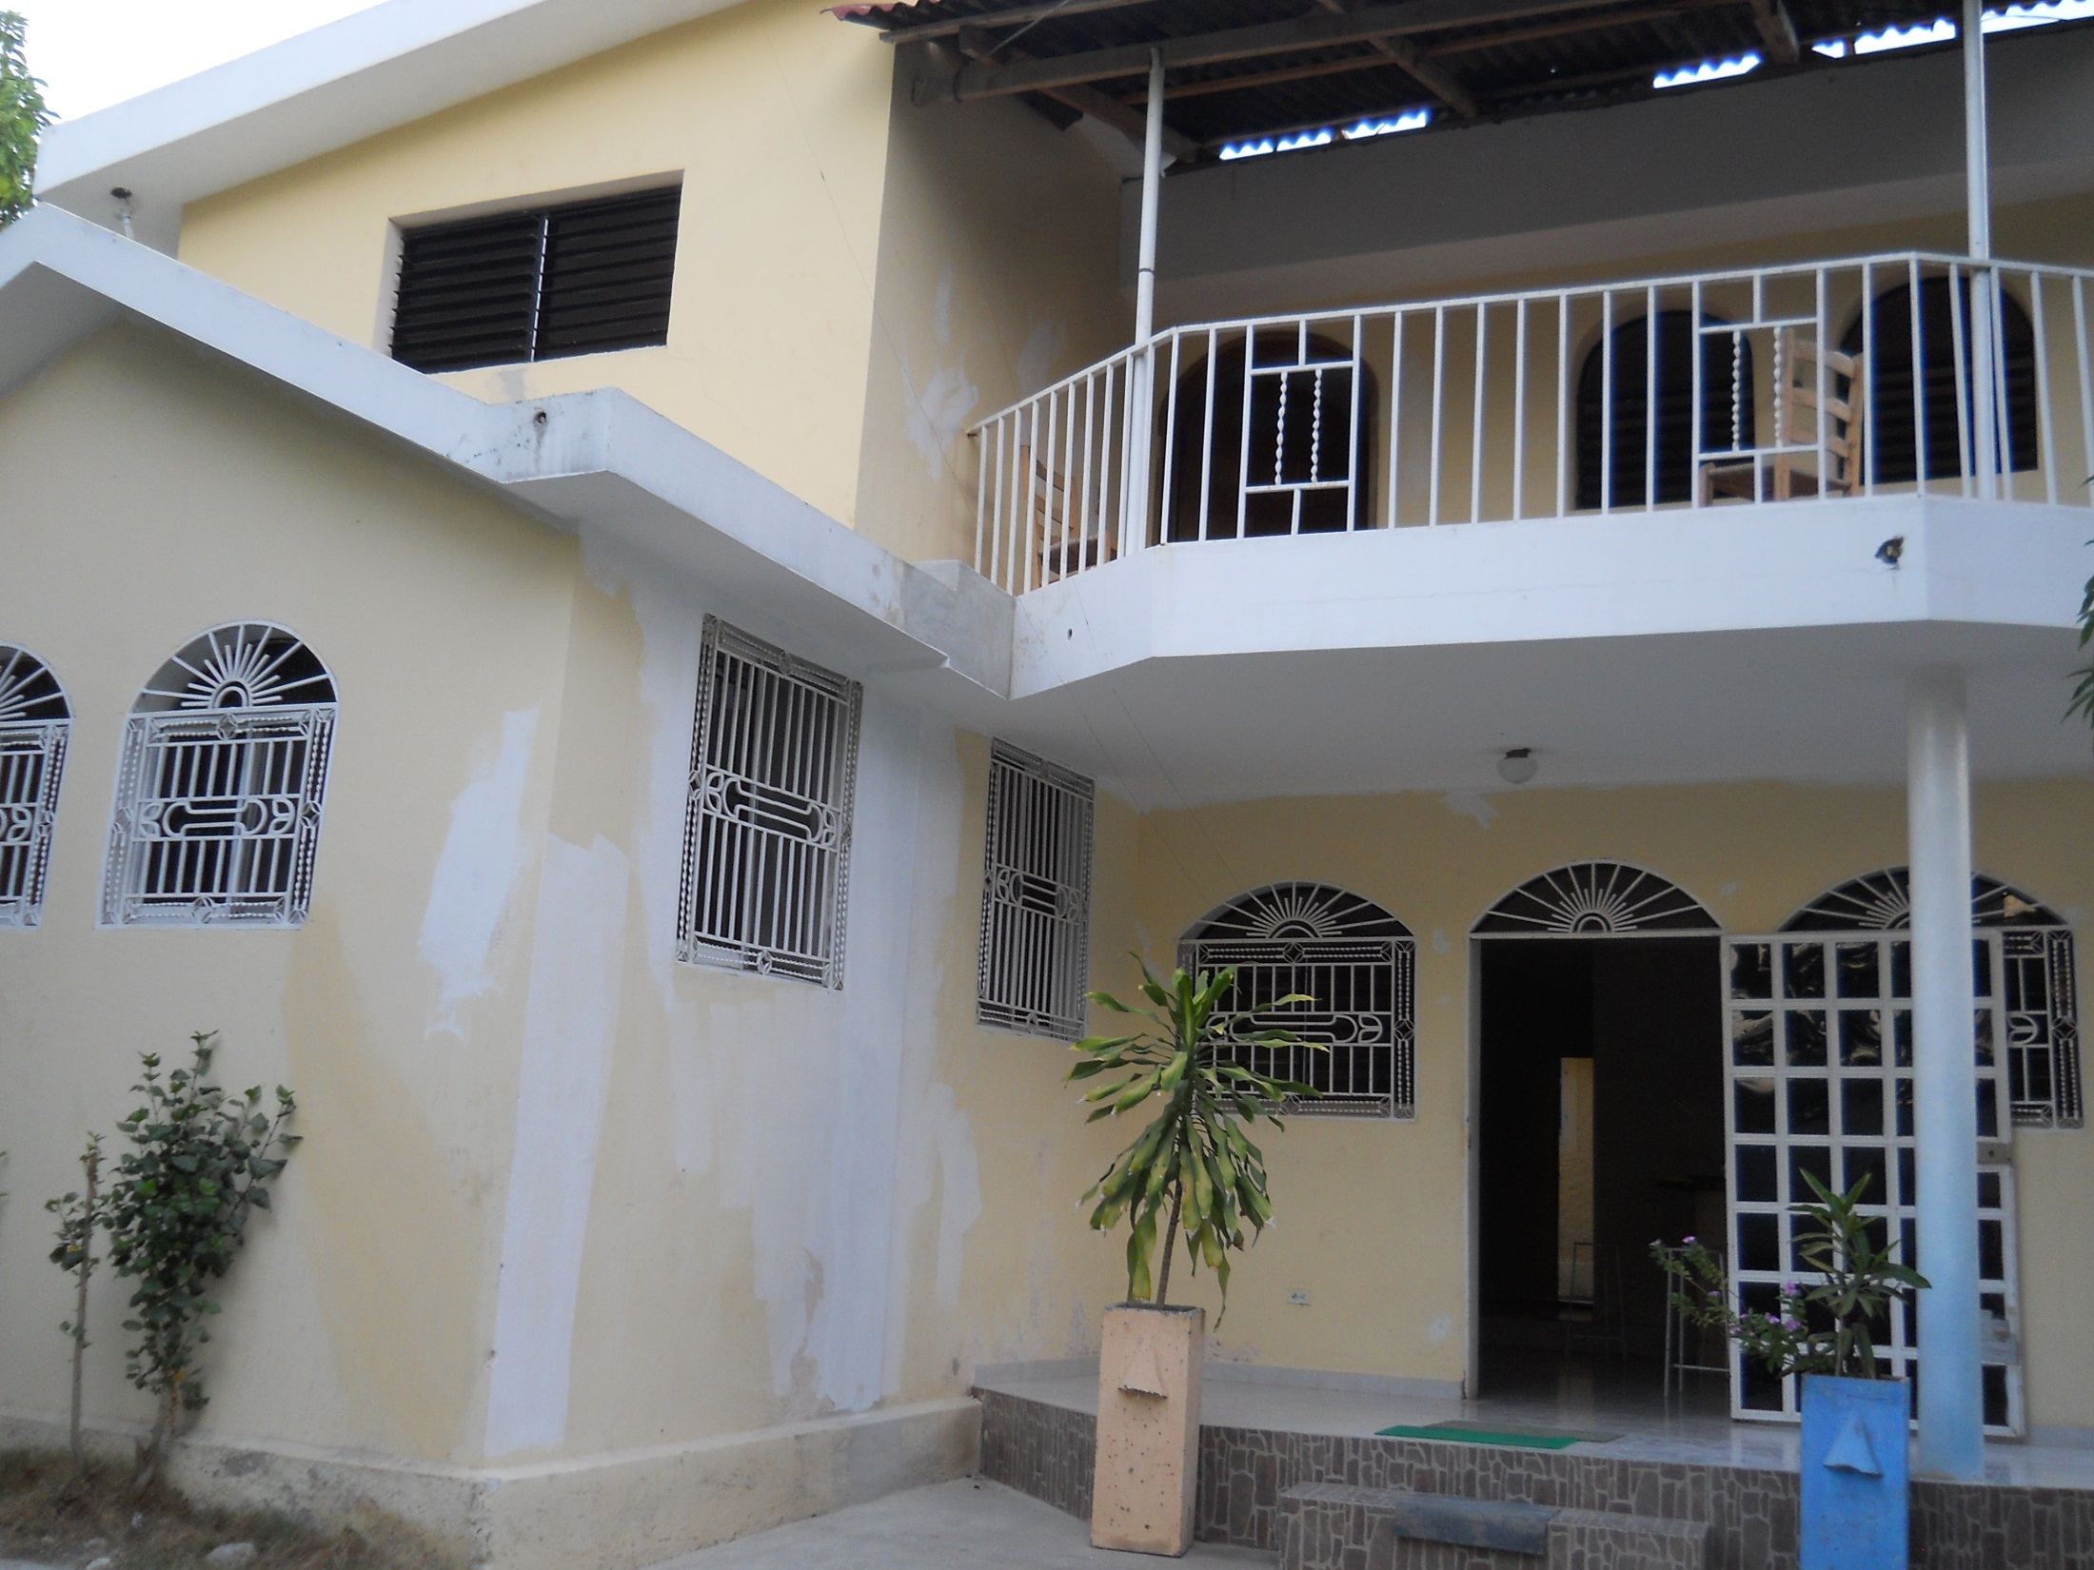

Slide 9
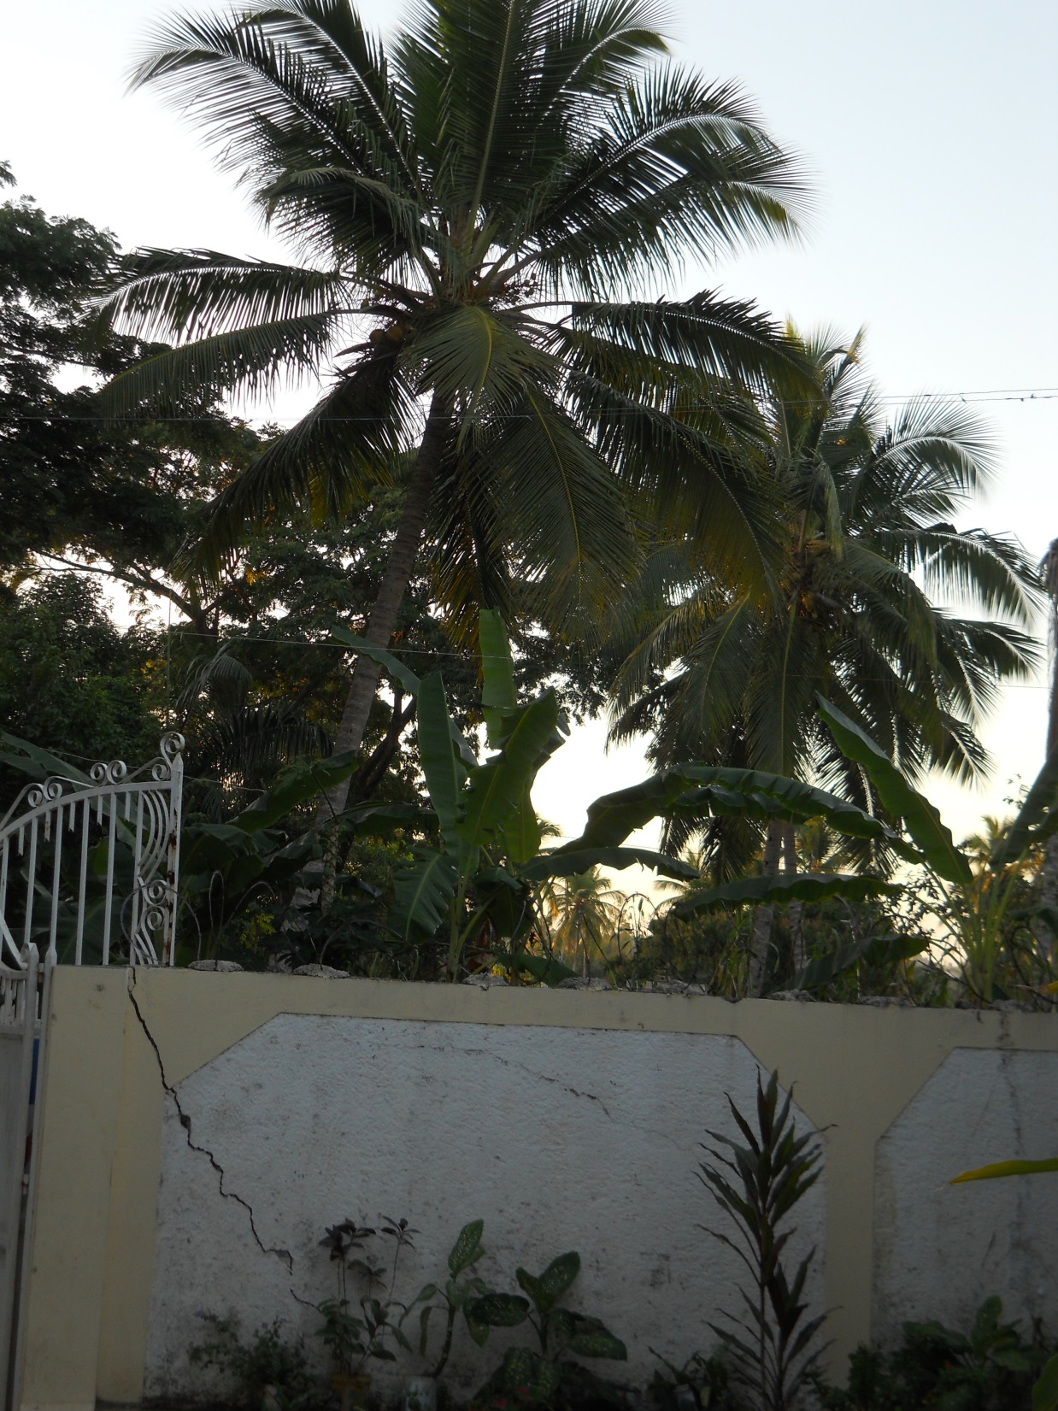

Slide 10
You could tell that these two diligent young men were happy to have a job. They welcomed the idea of being in the picture with Ken.

Slide 11
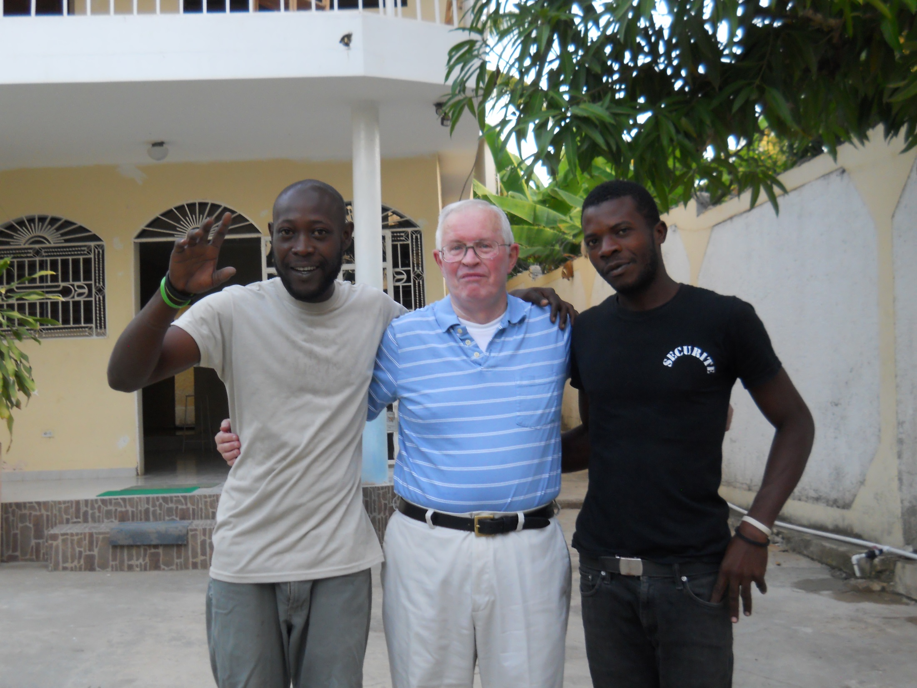

Slide 12
We were fed (wonderfully) by a group of nuns at a Pastoral Center, very close to the Blue Moon. At breakfast the first day, we drank coconut milk out of the coconut with a straw.

Slide 13
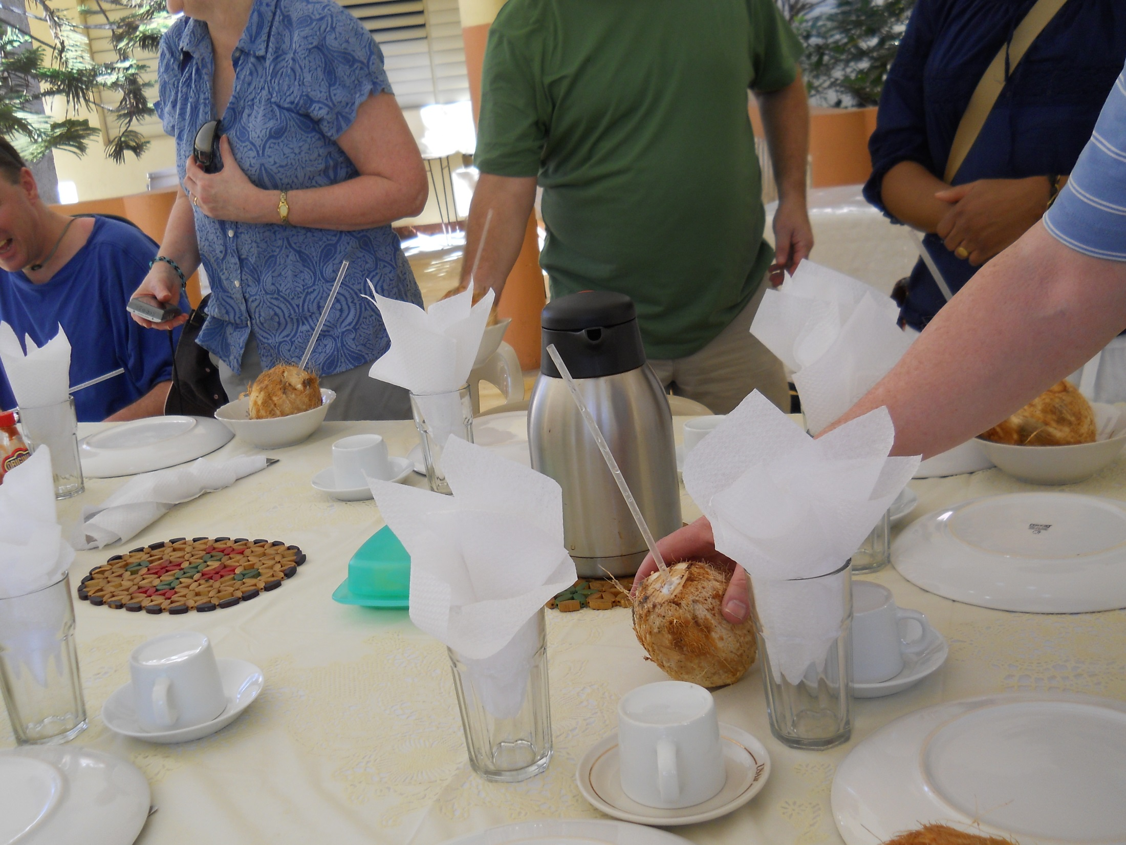

Slide 14
Father Bill Lohan, formerly of St. Martha’s Parish in Plainville, said Mass each morning at the home of the Felician Sisters. These nuns were among the most faith-filled and joyful people we had ever met.

Slide 15
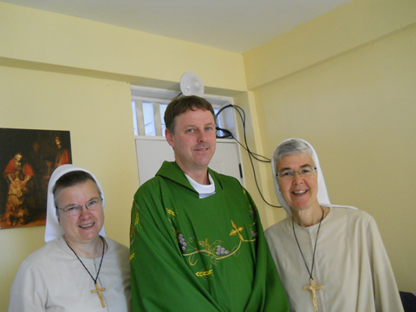

Slide 16
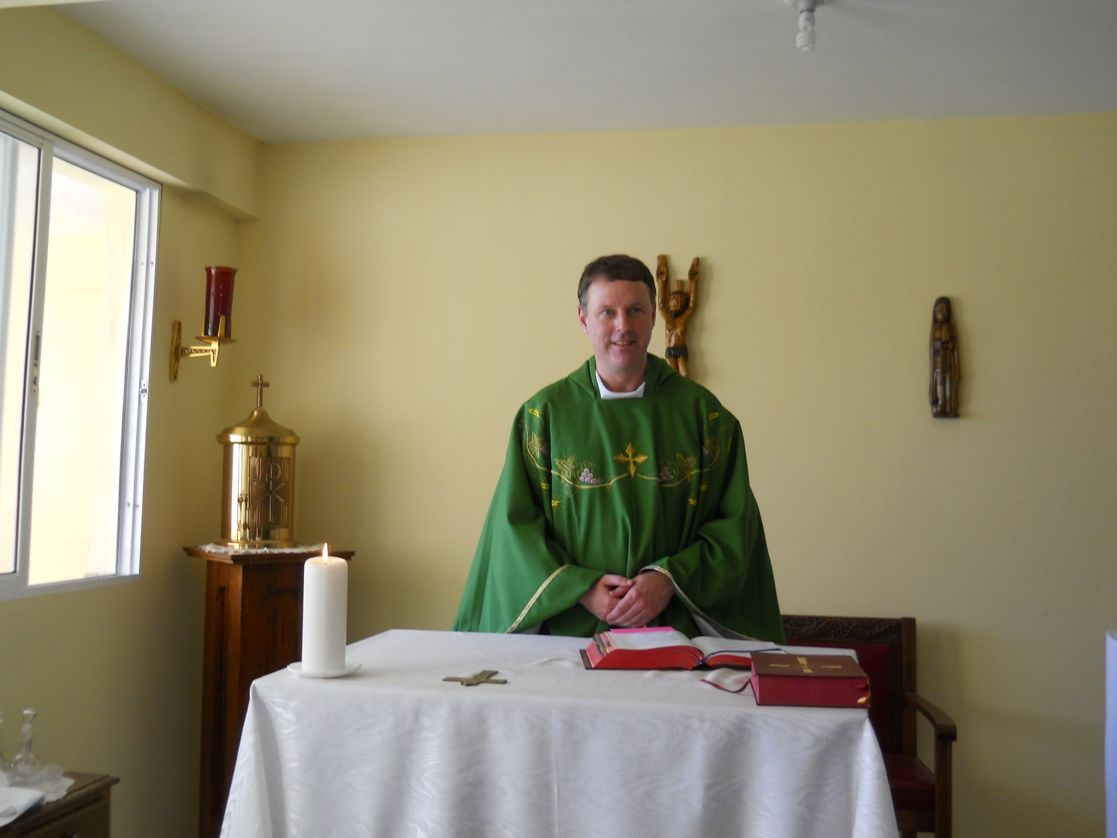

Slide 17
“Kizin Manman Angela,” or “Mother Angela’s Kitchen” is Jacmel’s soup kitchen. Mother Angela was the founder of the Felician Sisters, thus the name. The nuns do the procurement of the food, and the locals cook and serve it. The Haitians love bright colors and decorated this nicely.

Slide 18
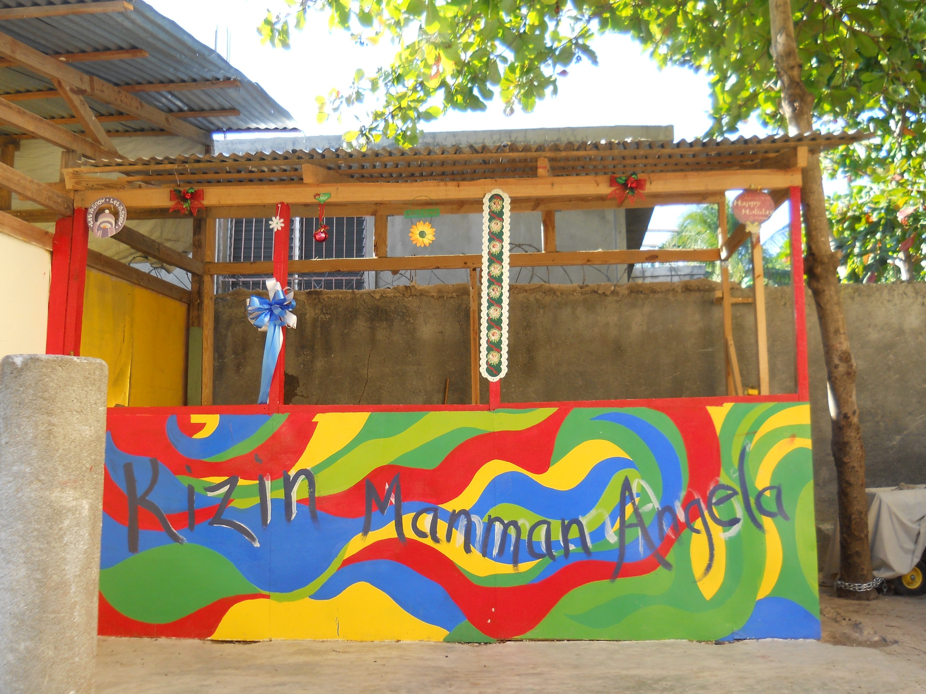

Slide 19
We loved that the place was kid-friendly, and depicted one of our favorite Americans.

Slide 20
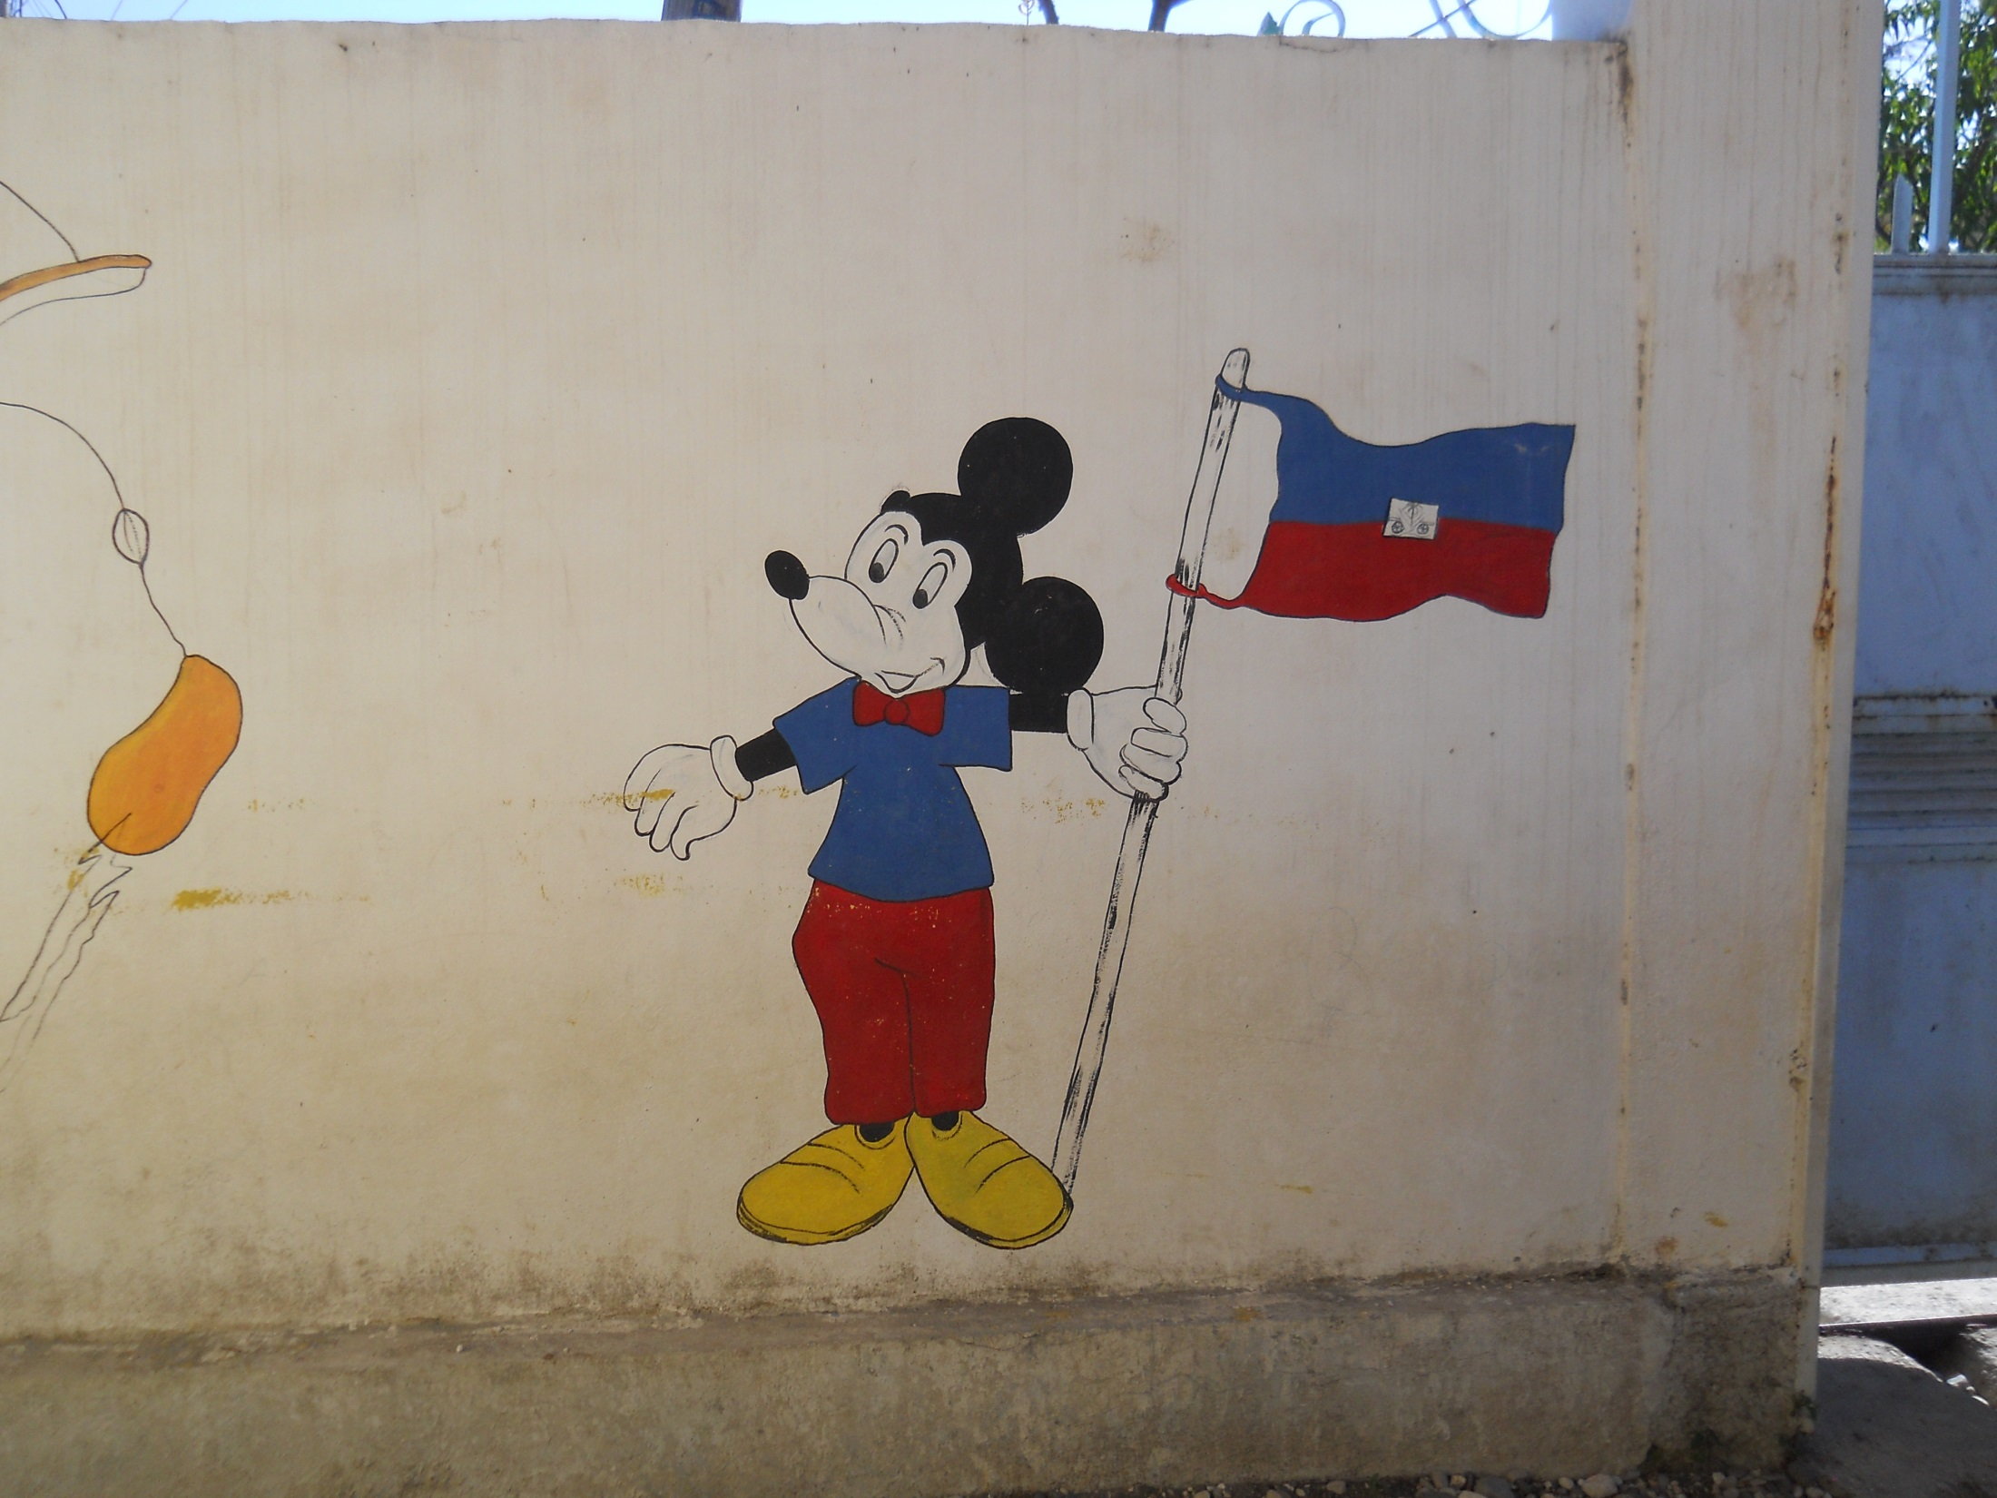

Slide 21
A parish in New Jersey sent school supplies to the sisters. It took them almost two months to get them out of customs, and even then, only after they had hired a broker. It seems the powers-that-be are hoping that people will give up, thus supplying the government with goods to sell.

Slide 22
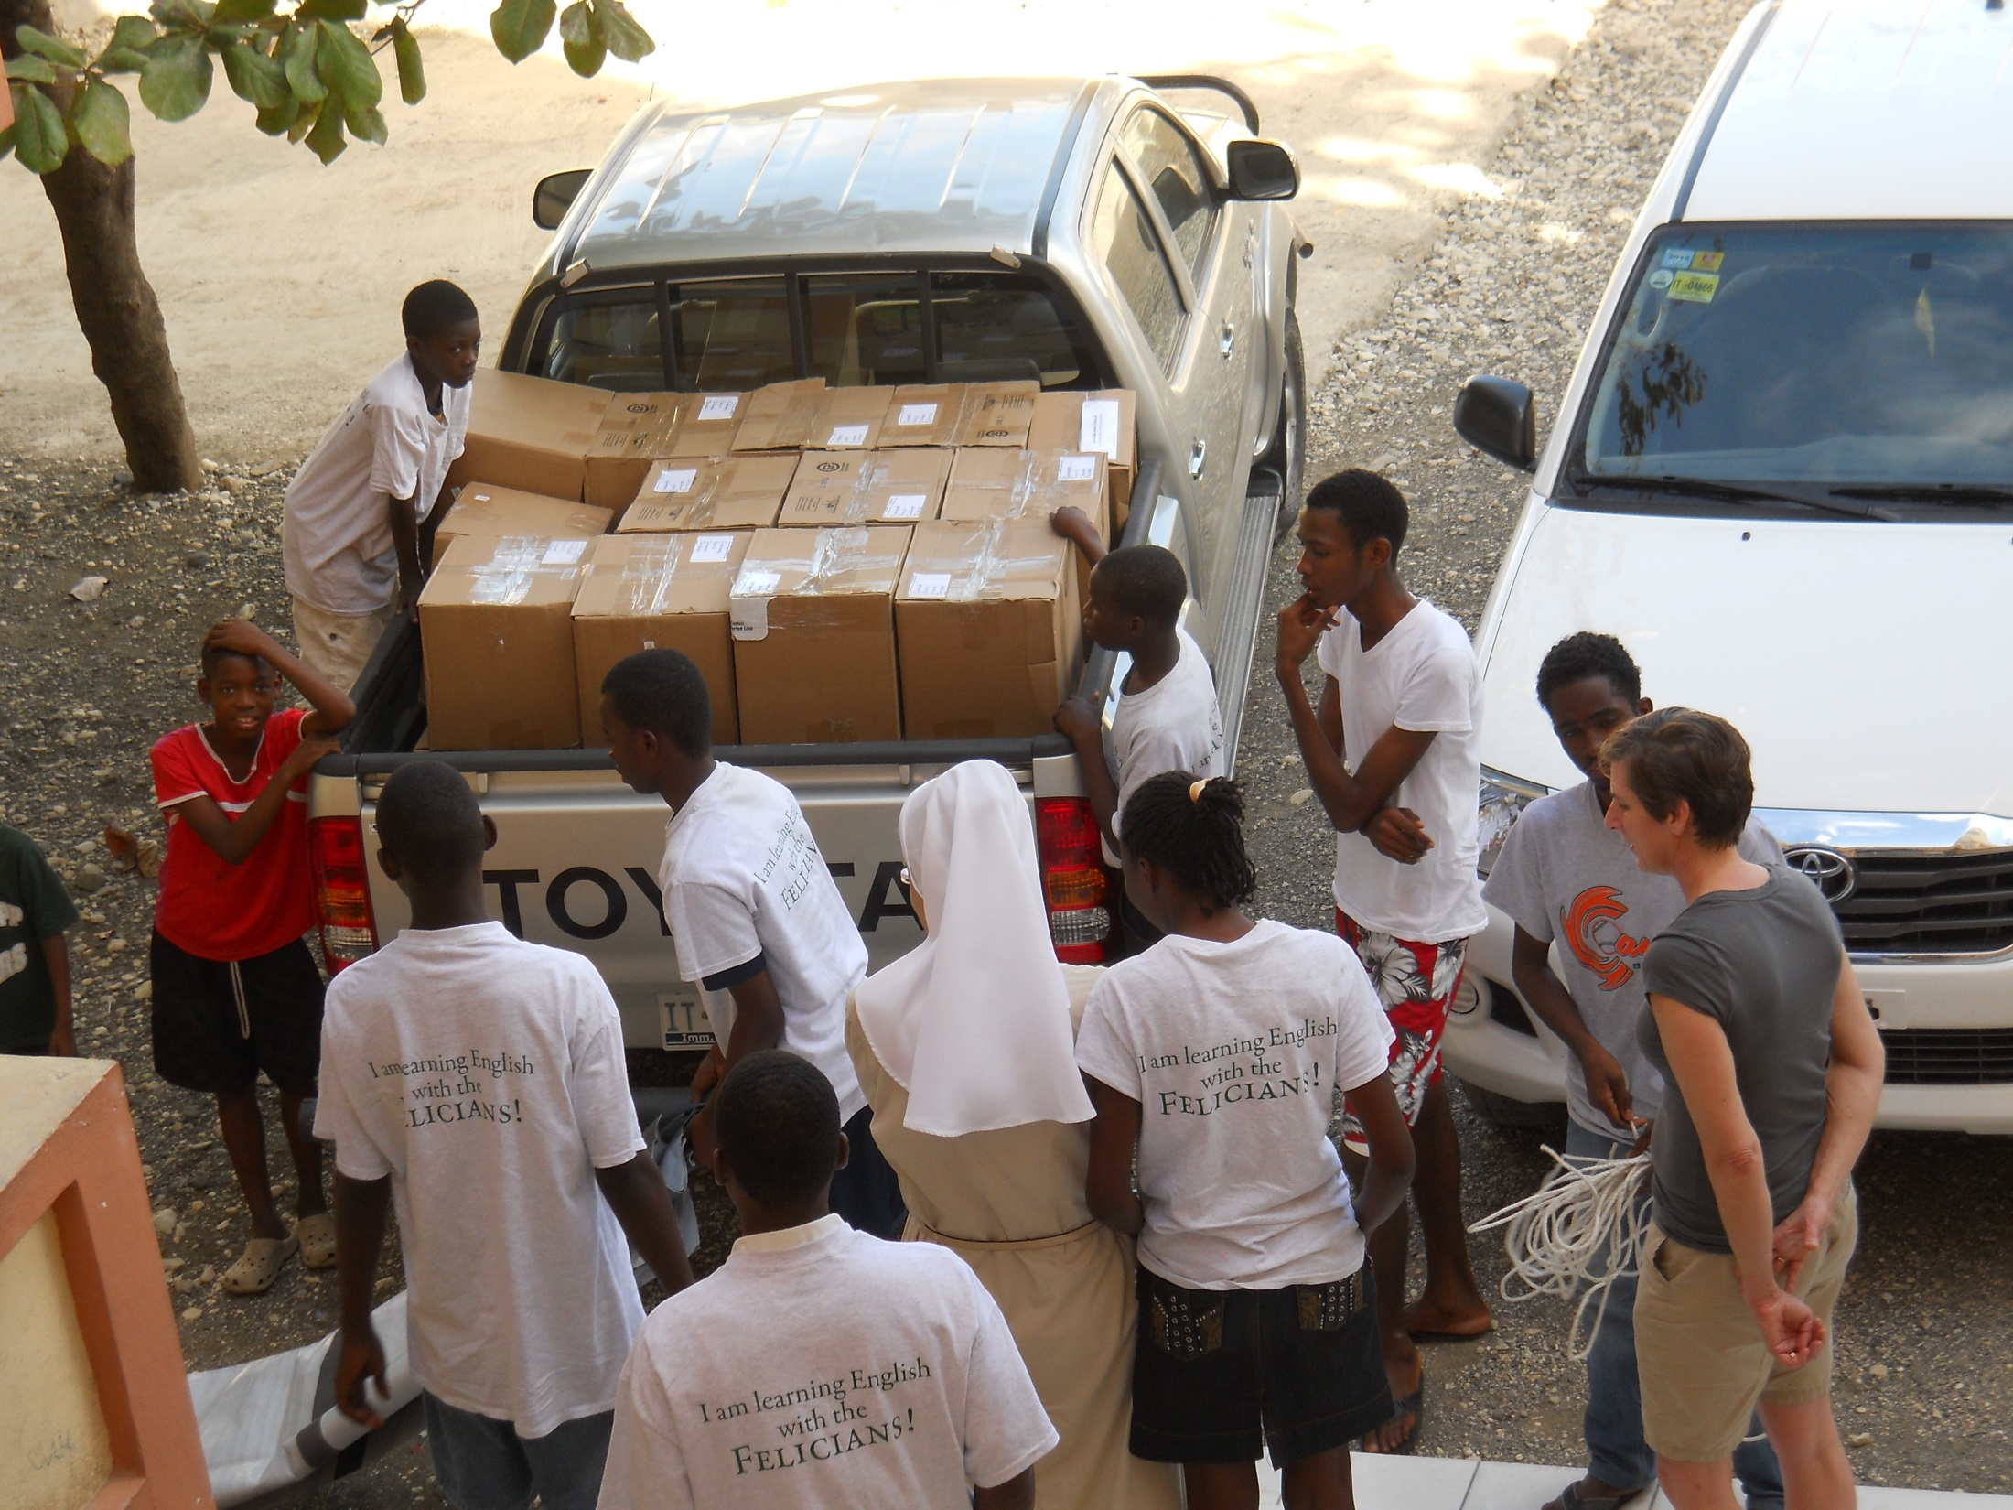

Slide 23
The school children loved greeting us and posing for the camera. Getting their children to school requires a great sacrifice for Haitian parents. Although school is mandatory “on paper,” in reality parents need to have a political connection and pay dearly to get their children educated.

Slide 24
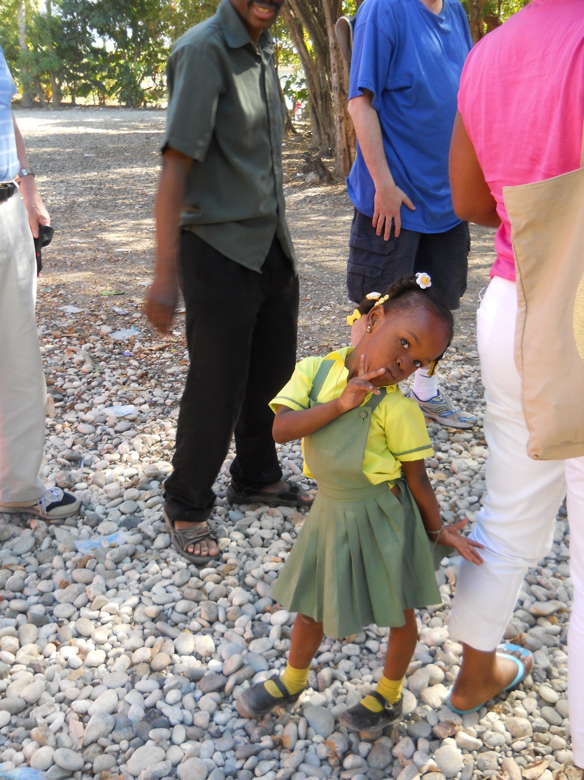

Slide 25
We were impressed that the children were so well groomed and dressed, coming from homes that have little or no electricity.

Slide 26
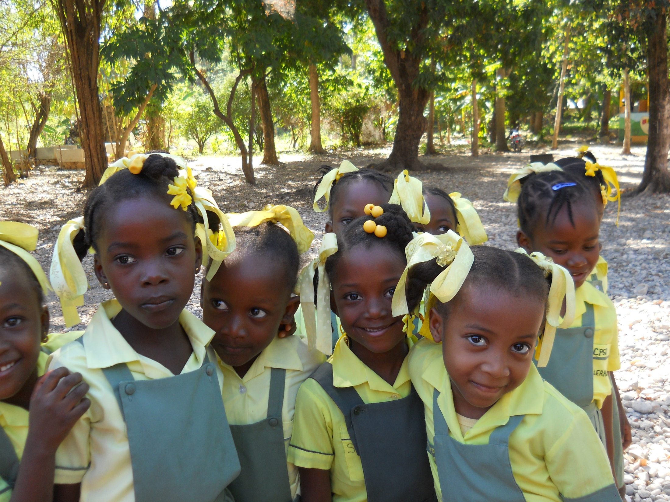

Slide 27
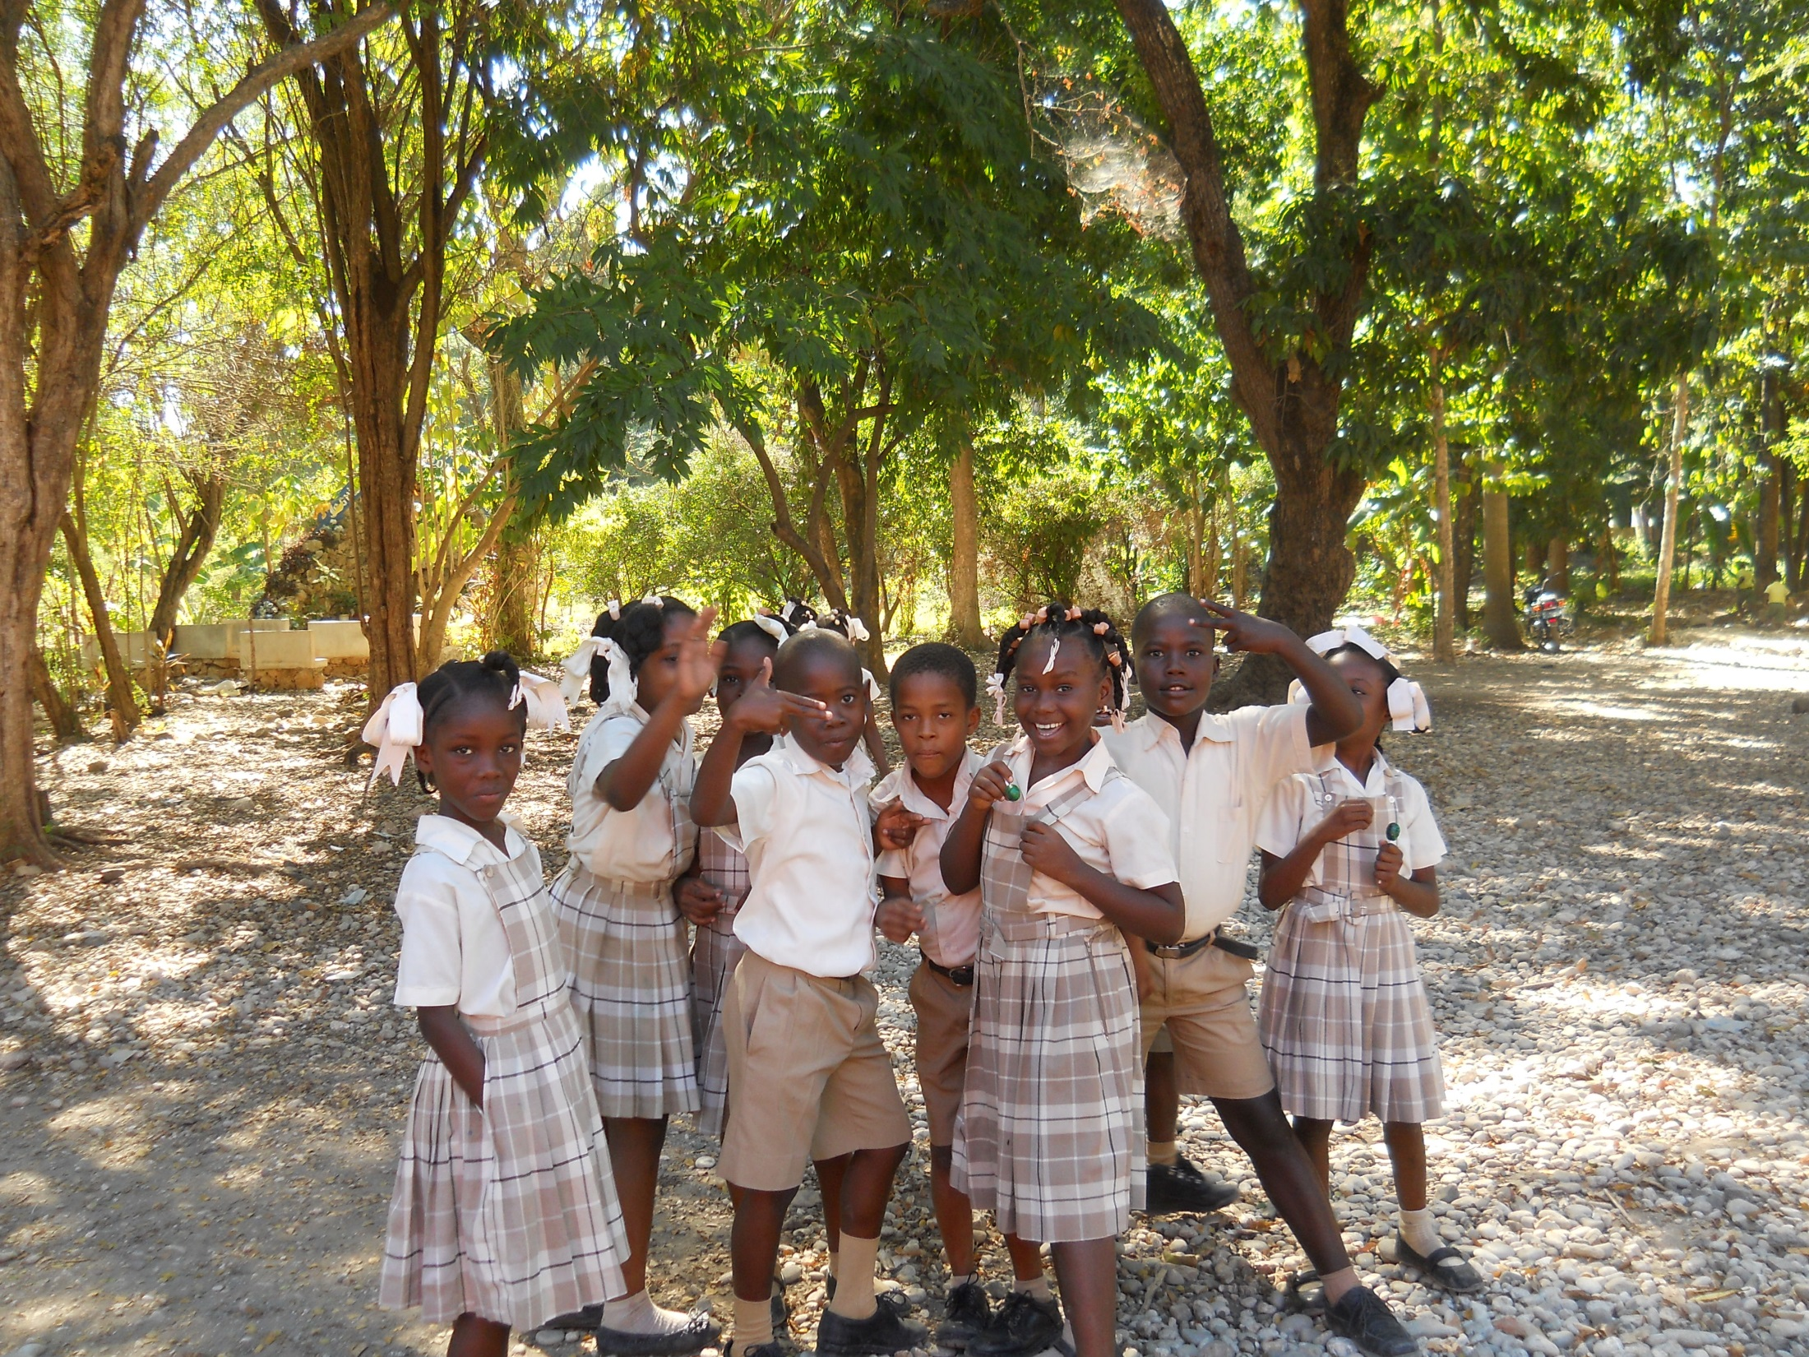

Slide 28
We were warmly welcomed by Bishop Lenay, the bishop of Jacmel. He invited us to his balcony, where we were served cold drinks and snacks. He discussed the needs of his people and the oppression and hardships they have endured.

Slide 29
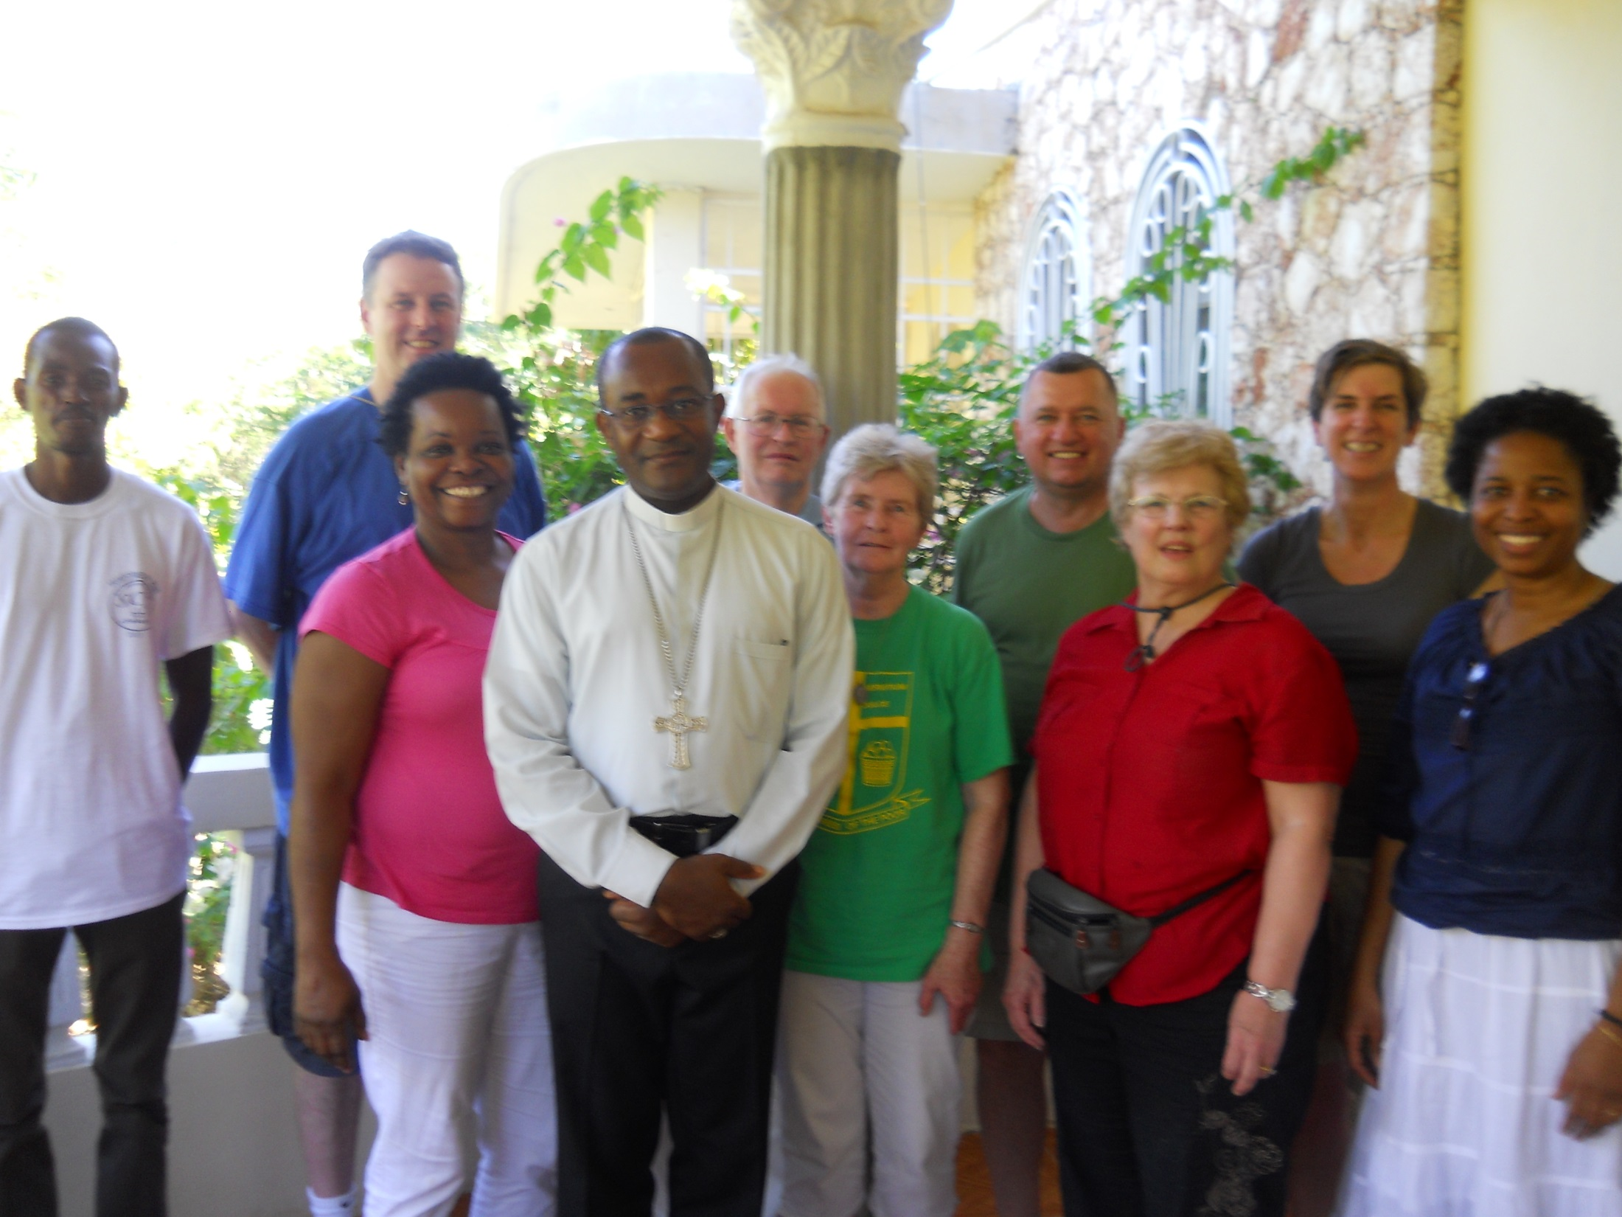

Slide 30
Everyone drives mopeds, aka “motos.”

Slide 31
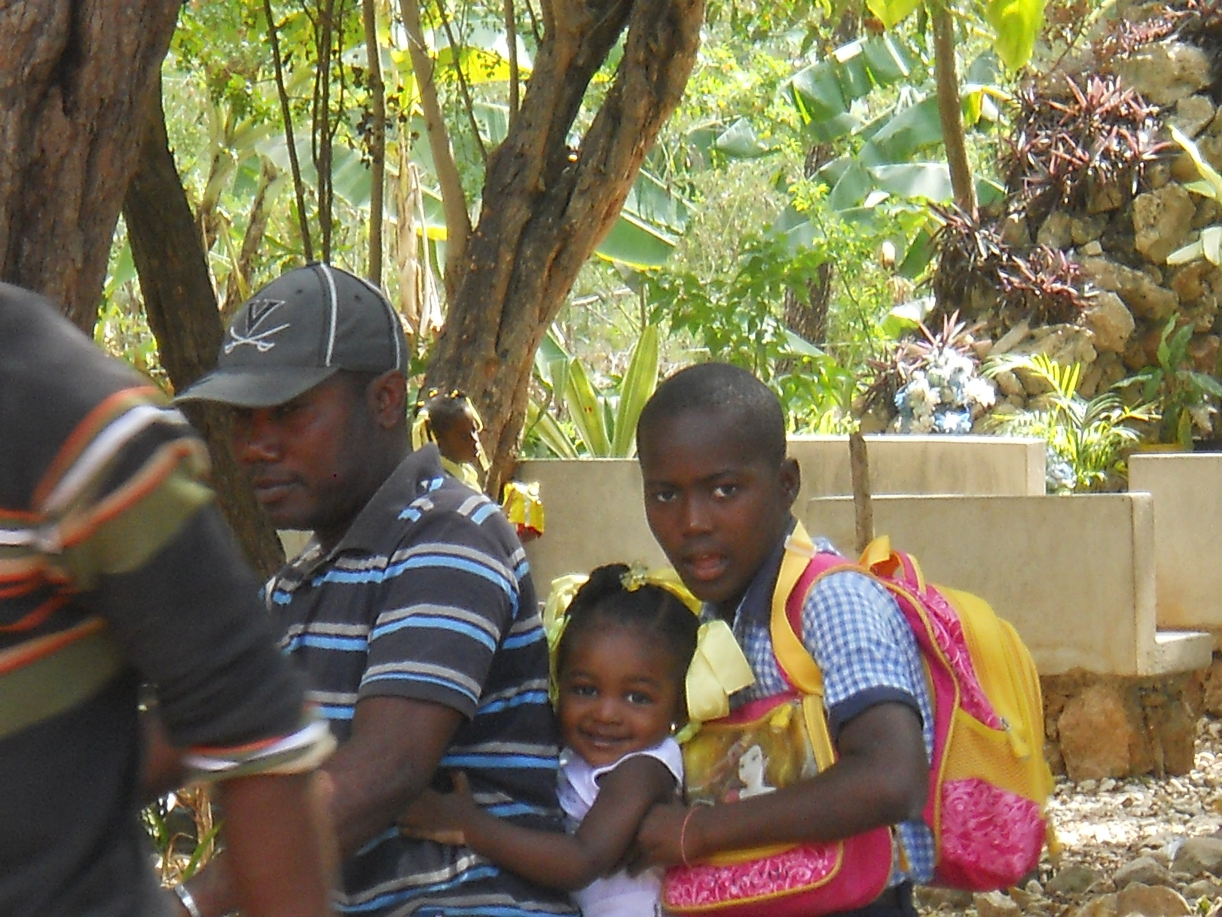

Slide 32
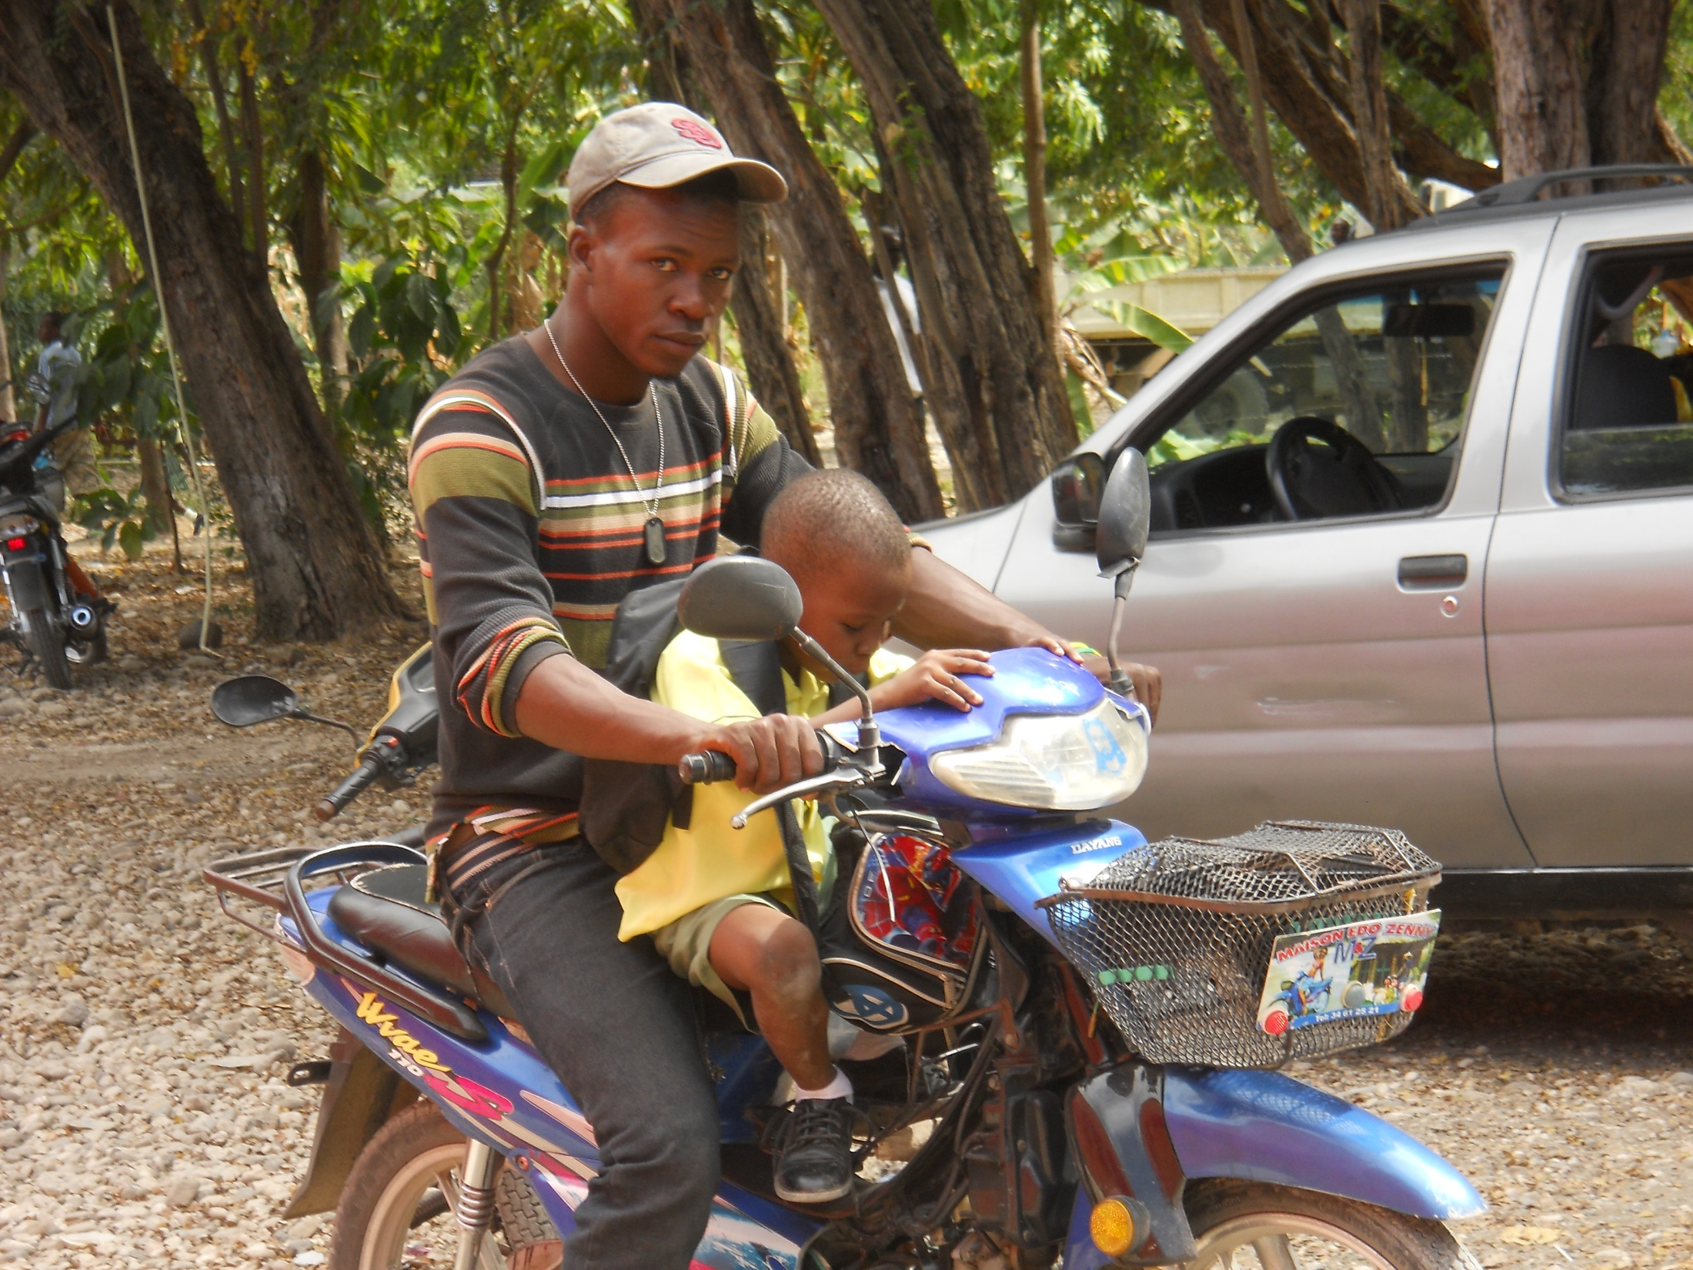

Slide 33
Note the high exhaust pipe on this vehicle. It enabled us to drive through a river of about 2-foot high water.

Slide 34
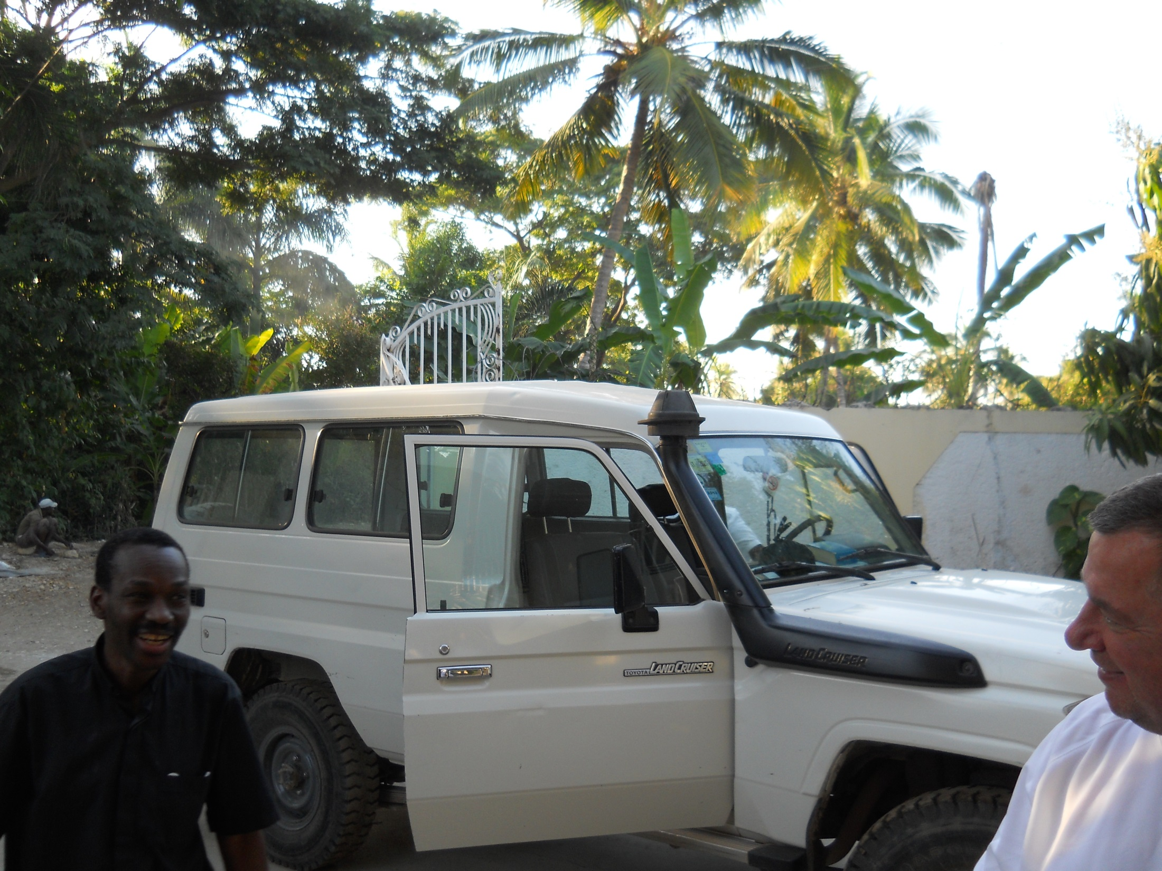

Slide 35
A beautiful view of the seashore.

Slide 36
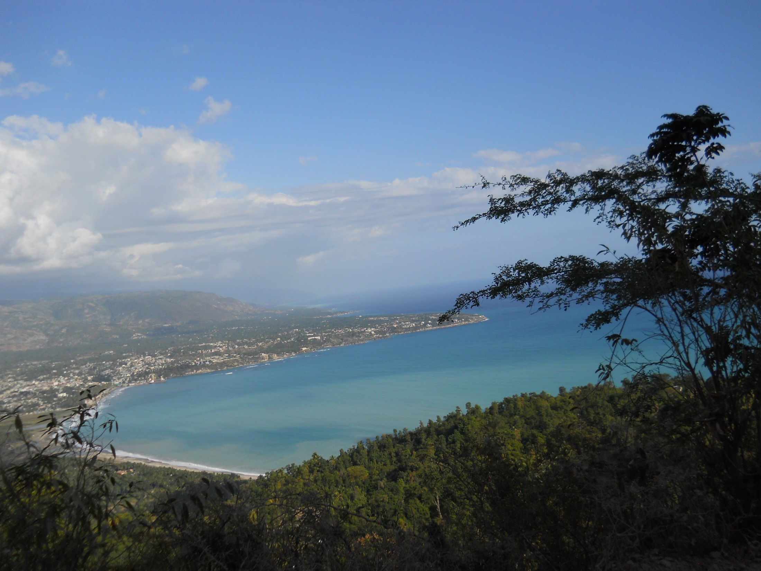

Slide 37
We traveled up a mountain to meet Fr. Jean Pierre’s mother. We met at this church. Fr.’s mother came halfway down; we traveled halfway up.

Slide 38
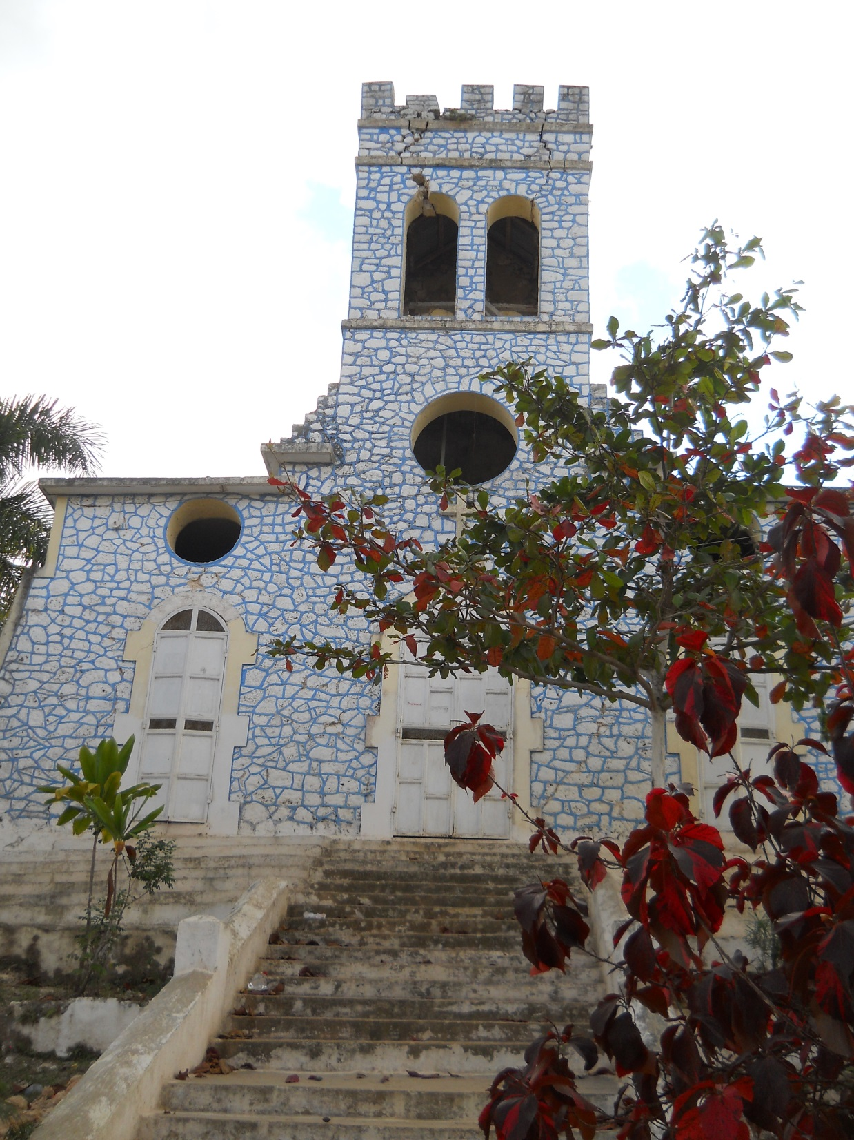

Slide 39
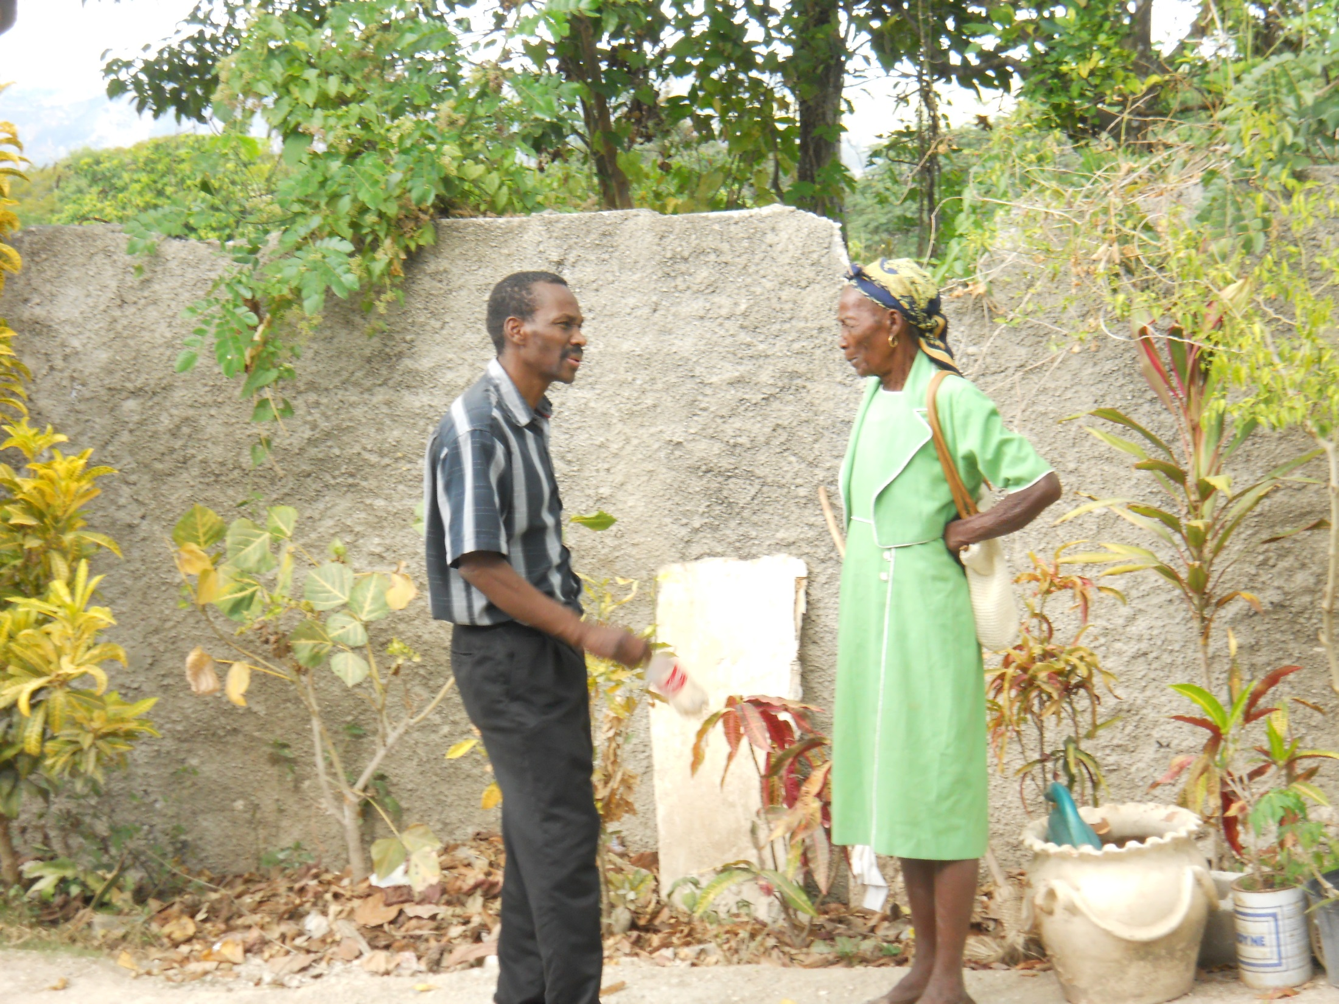

Slide 40
Fr. Aubin, his mom, and his brother Rubin. Rubin was our go-to person for rides, bottled water, and other needs.

Slide 41
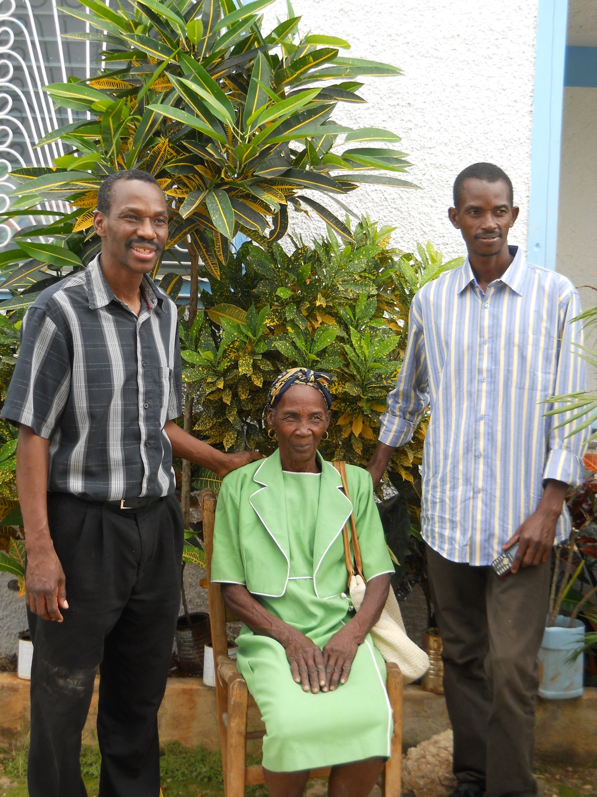

Slide 42
Mom’s vehicle.

Slide 43
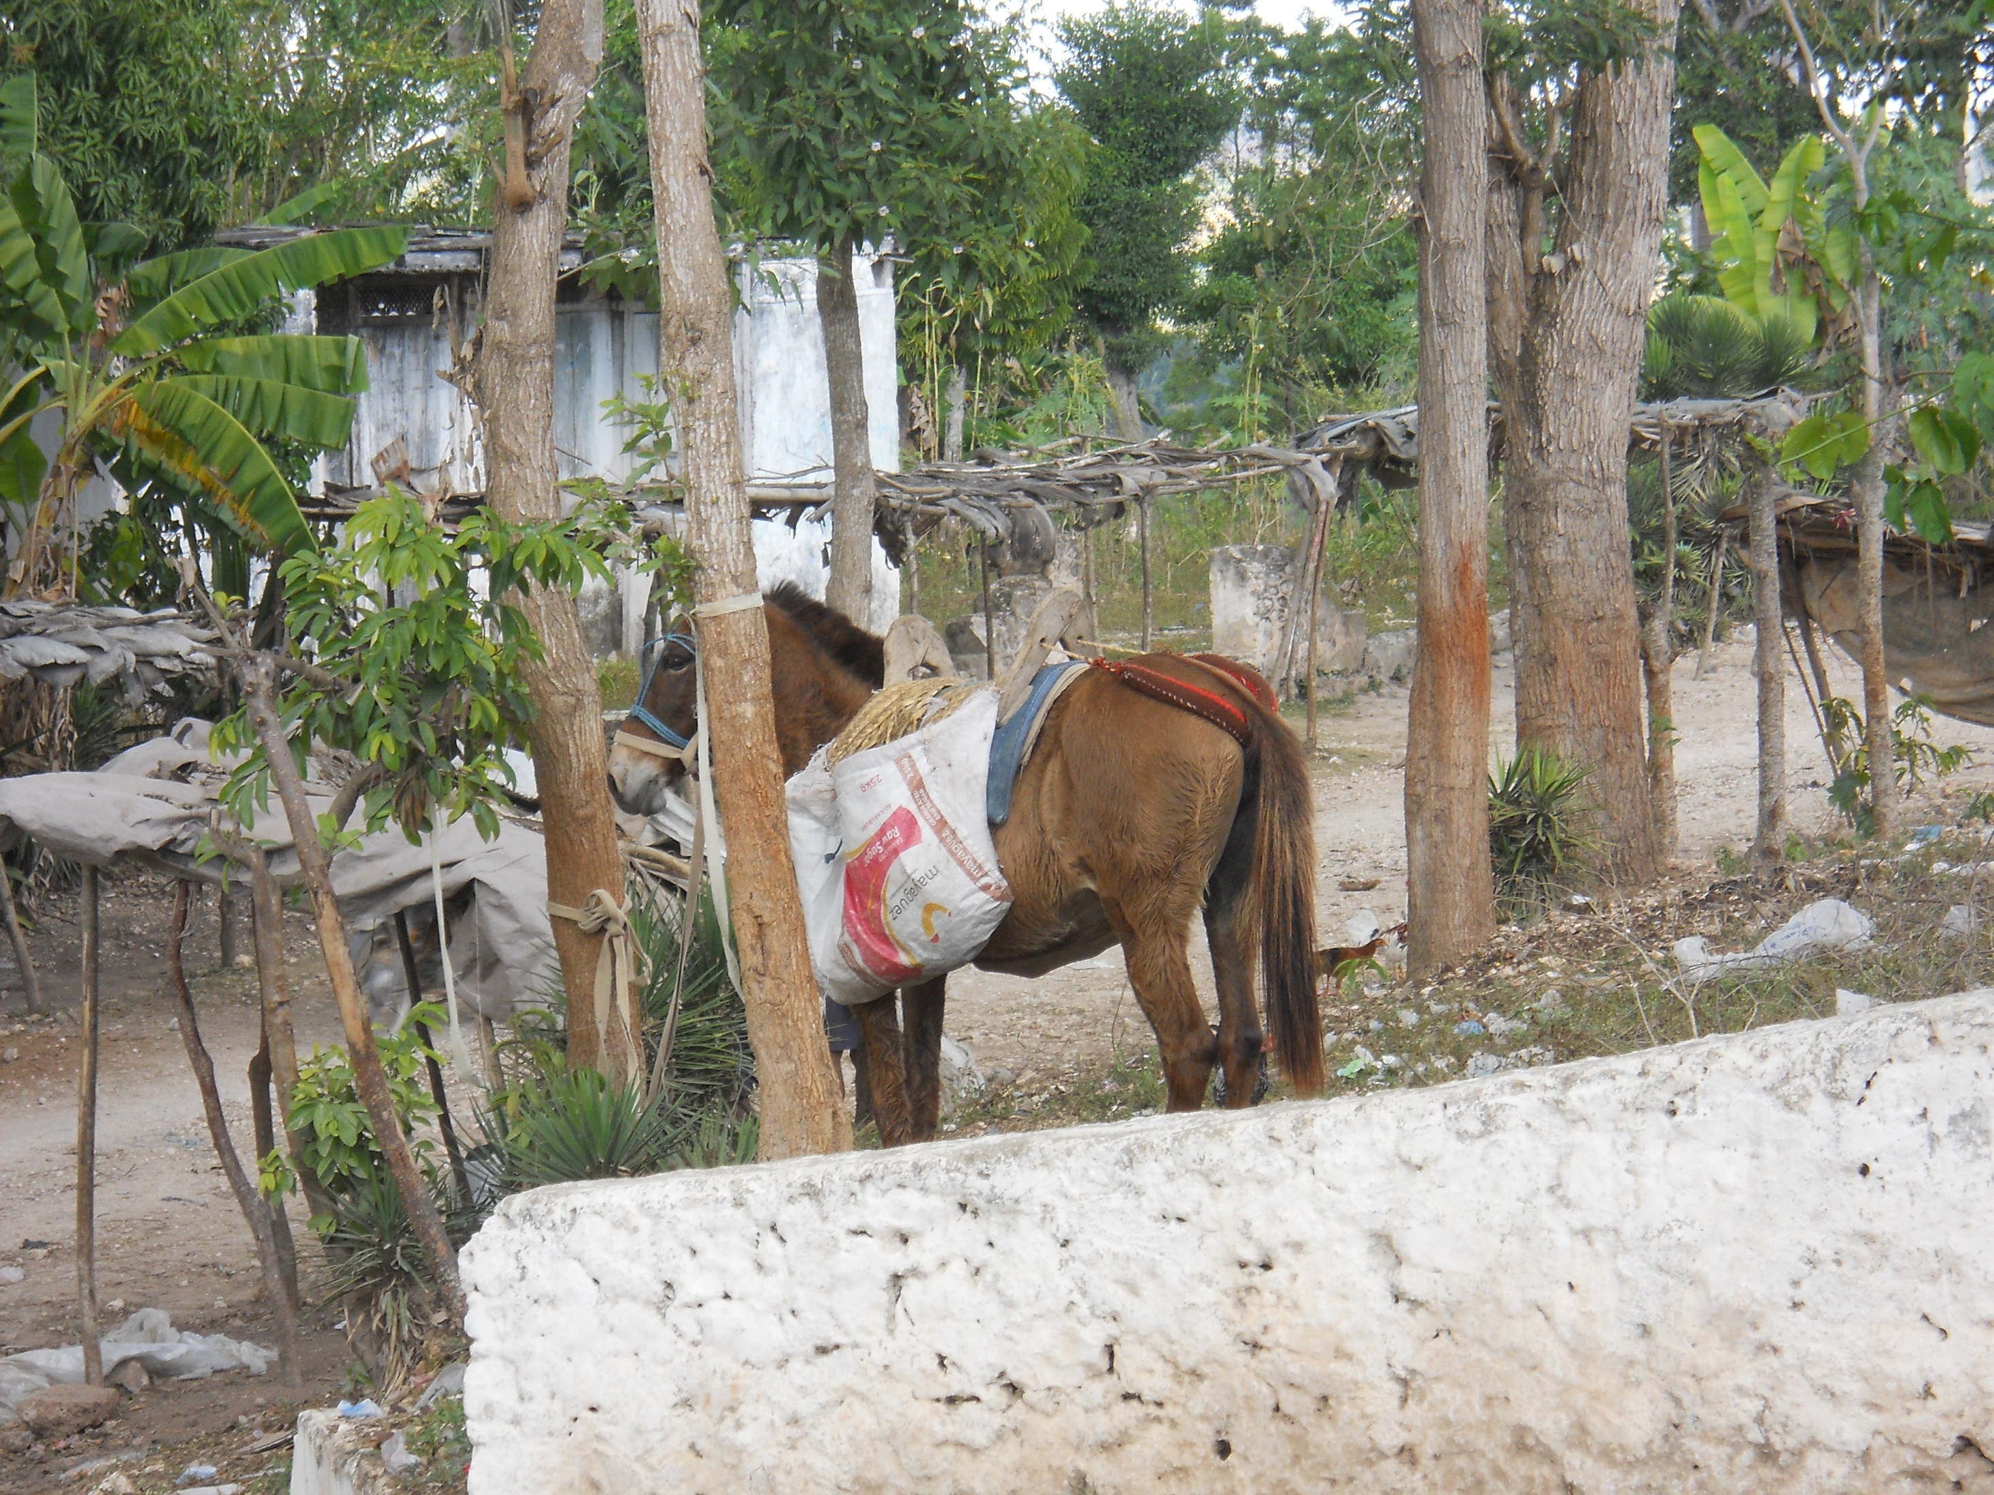

Slide 44
We toured the inside of the church, where destruction from the earthquake was still being repaired. We were told not to walk down the aisle, as it may still pose a safety threat.

Slide 45
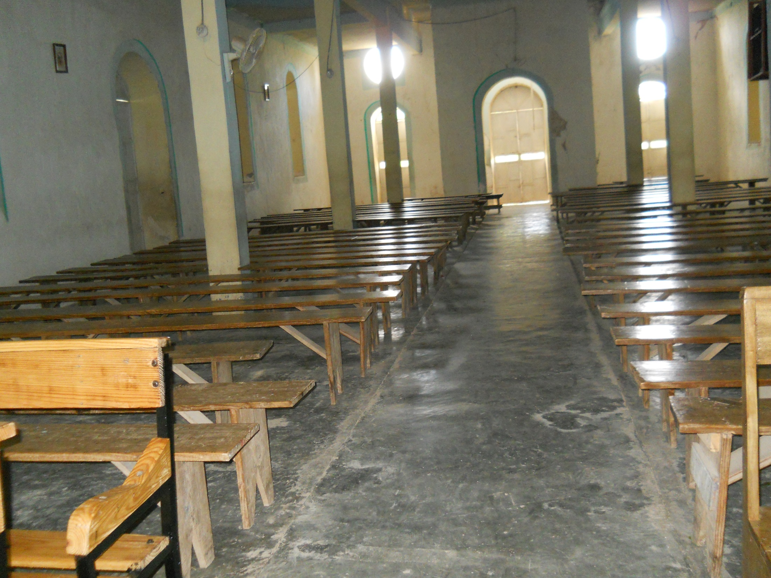

Slide 46
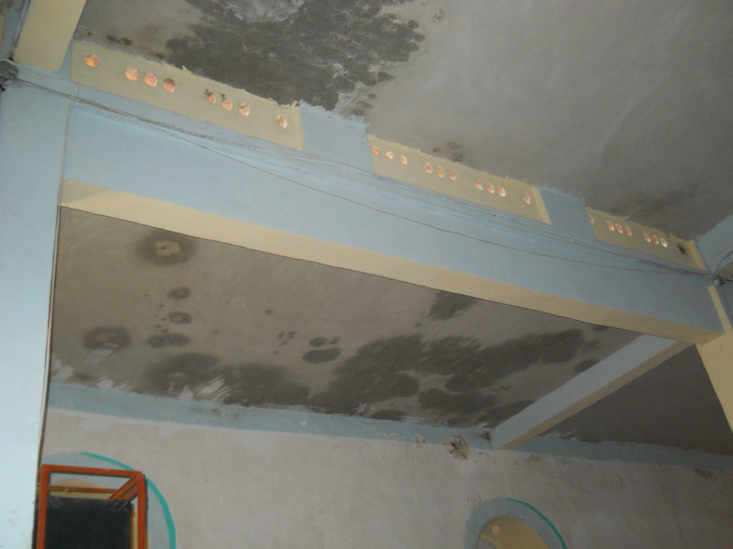

Slide 47
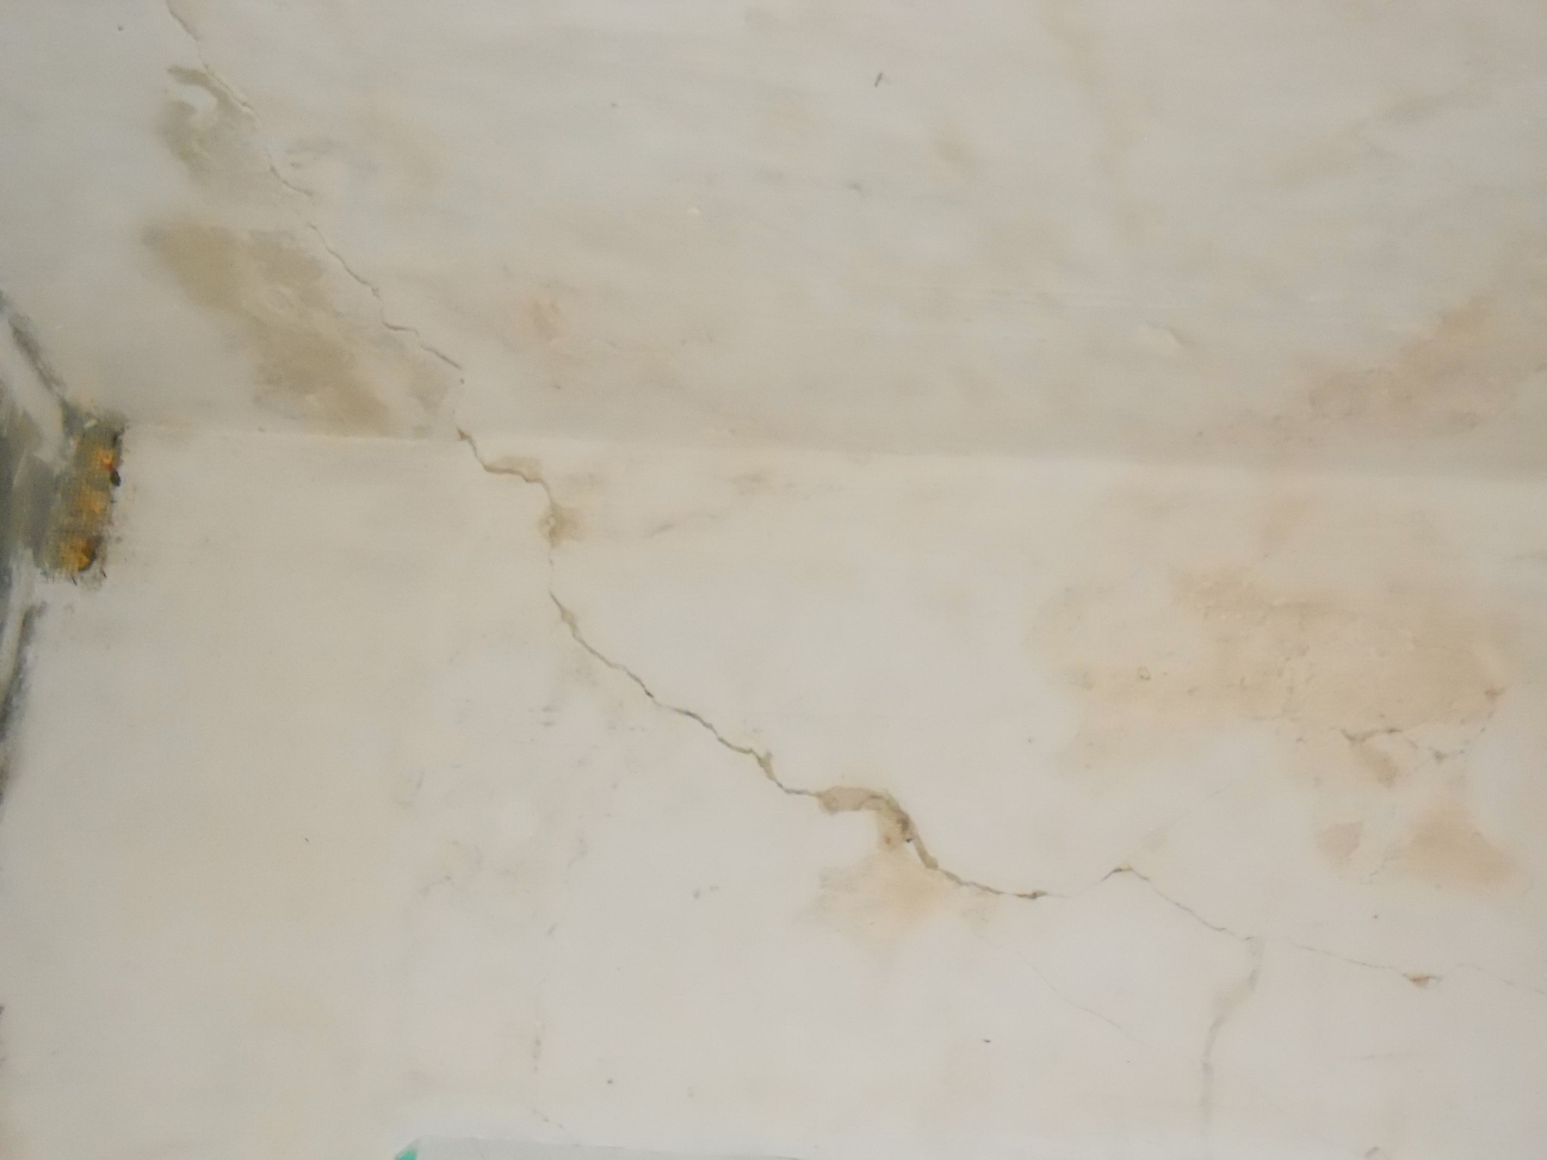

Slide 48
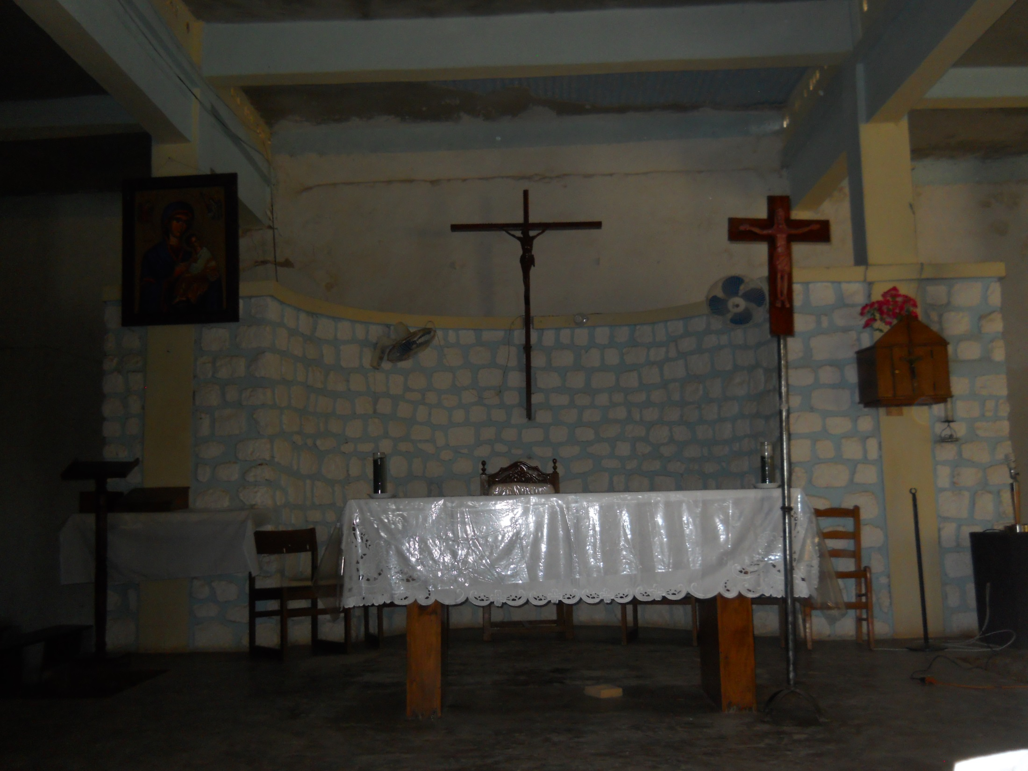

Slide 49
Back in Jacmel. This is the site of a church that had to be razed after the earthquake.

Slide 50
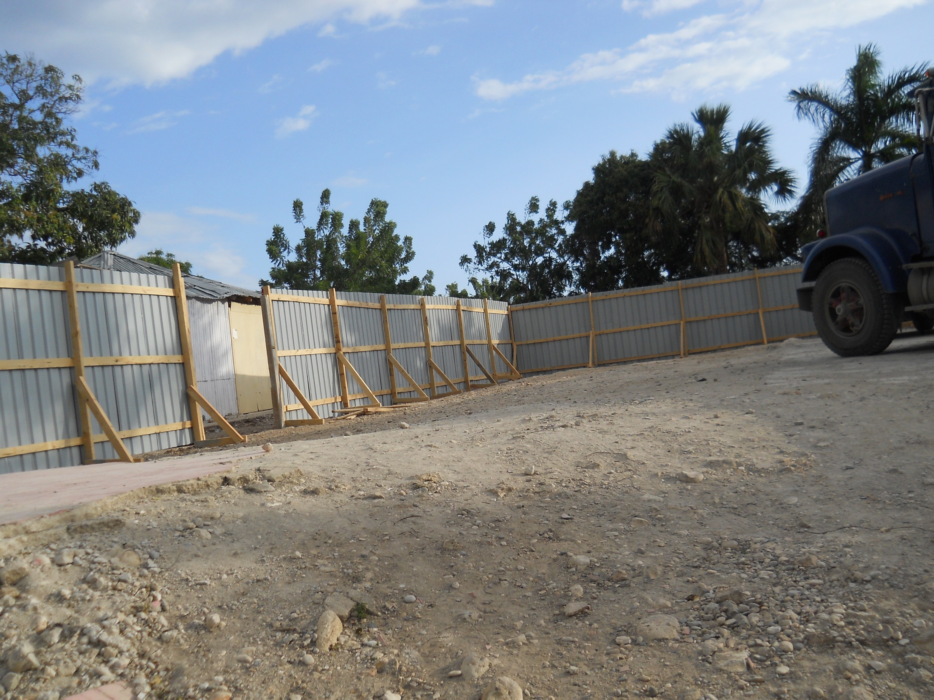

Slide 51
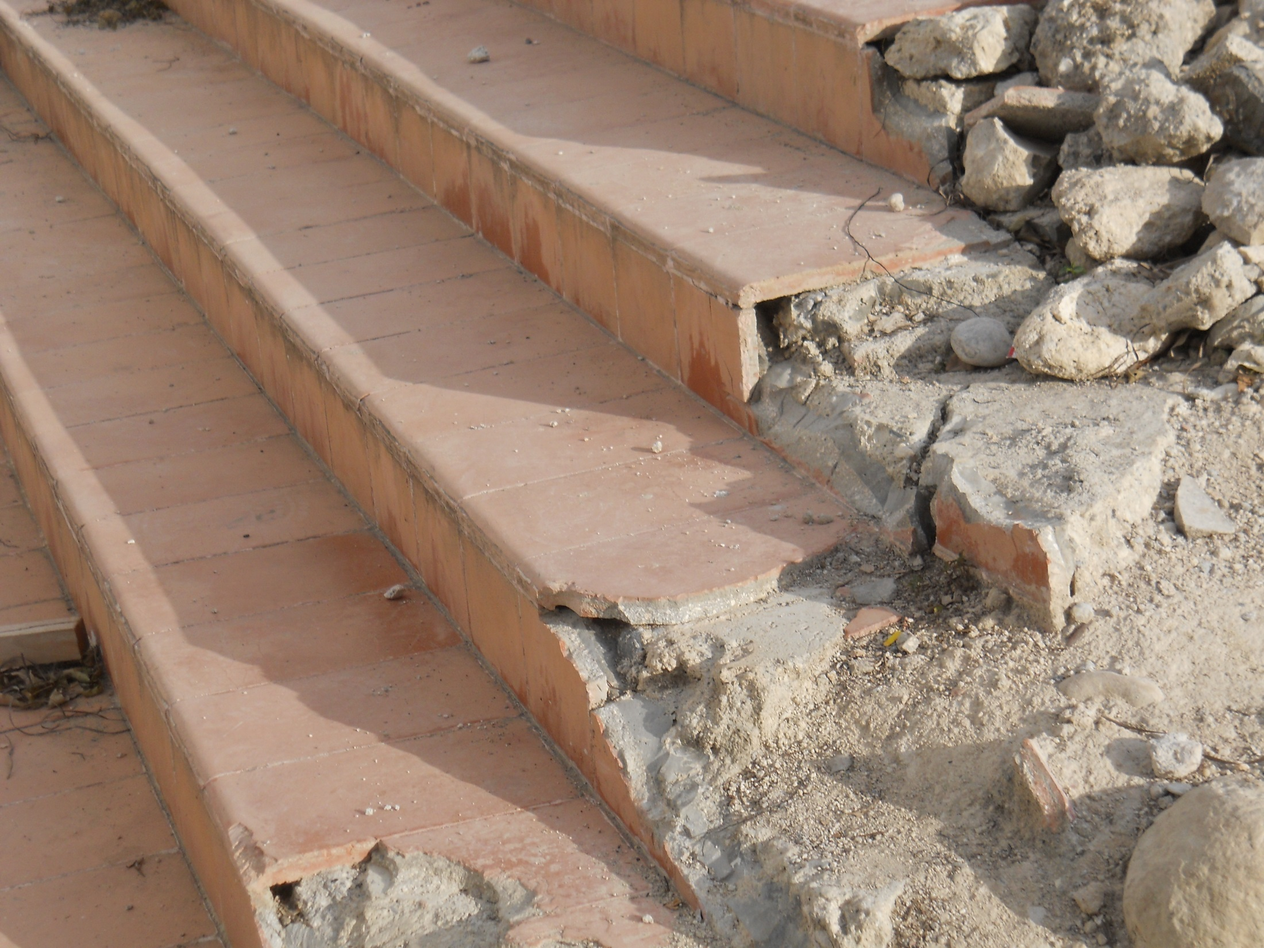

Slide 52
This is the land owned by Fr. Aubin; it is the future site of the school.

Slide 53
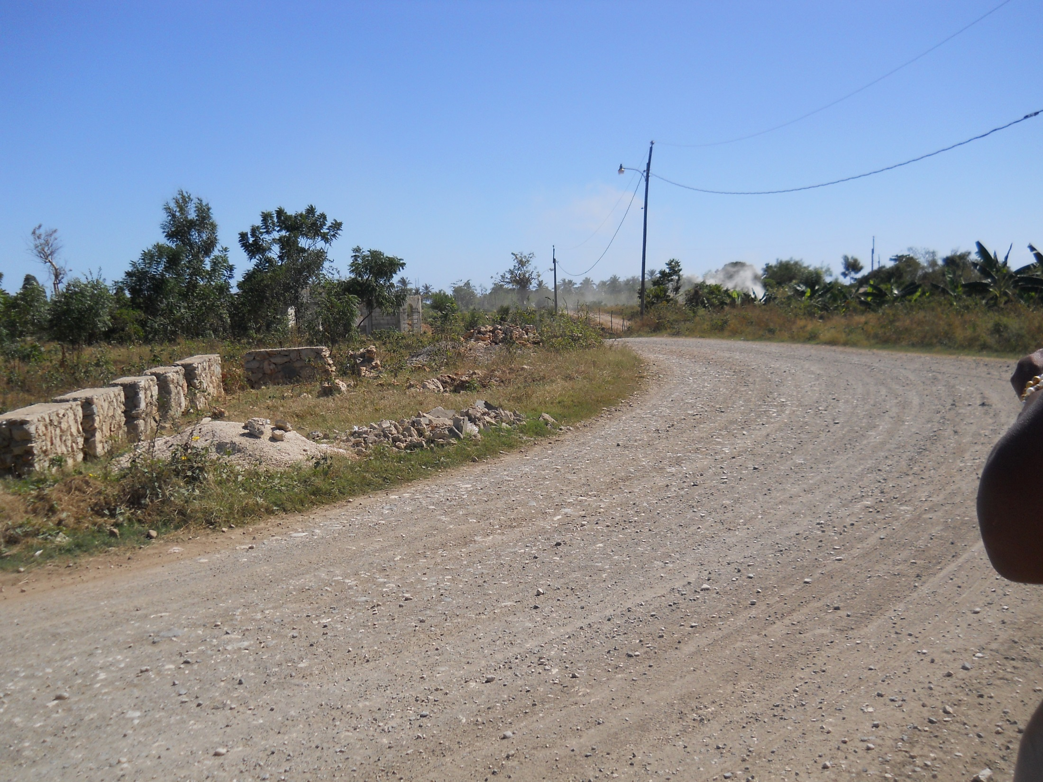

Slide 54
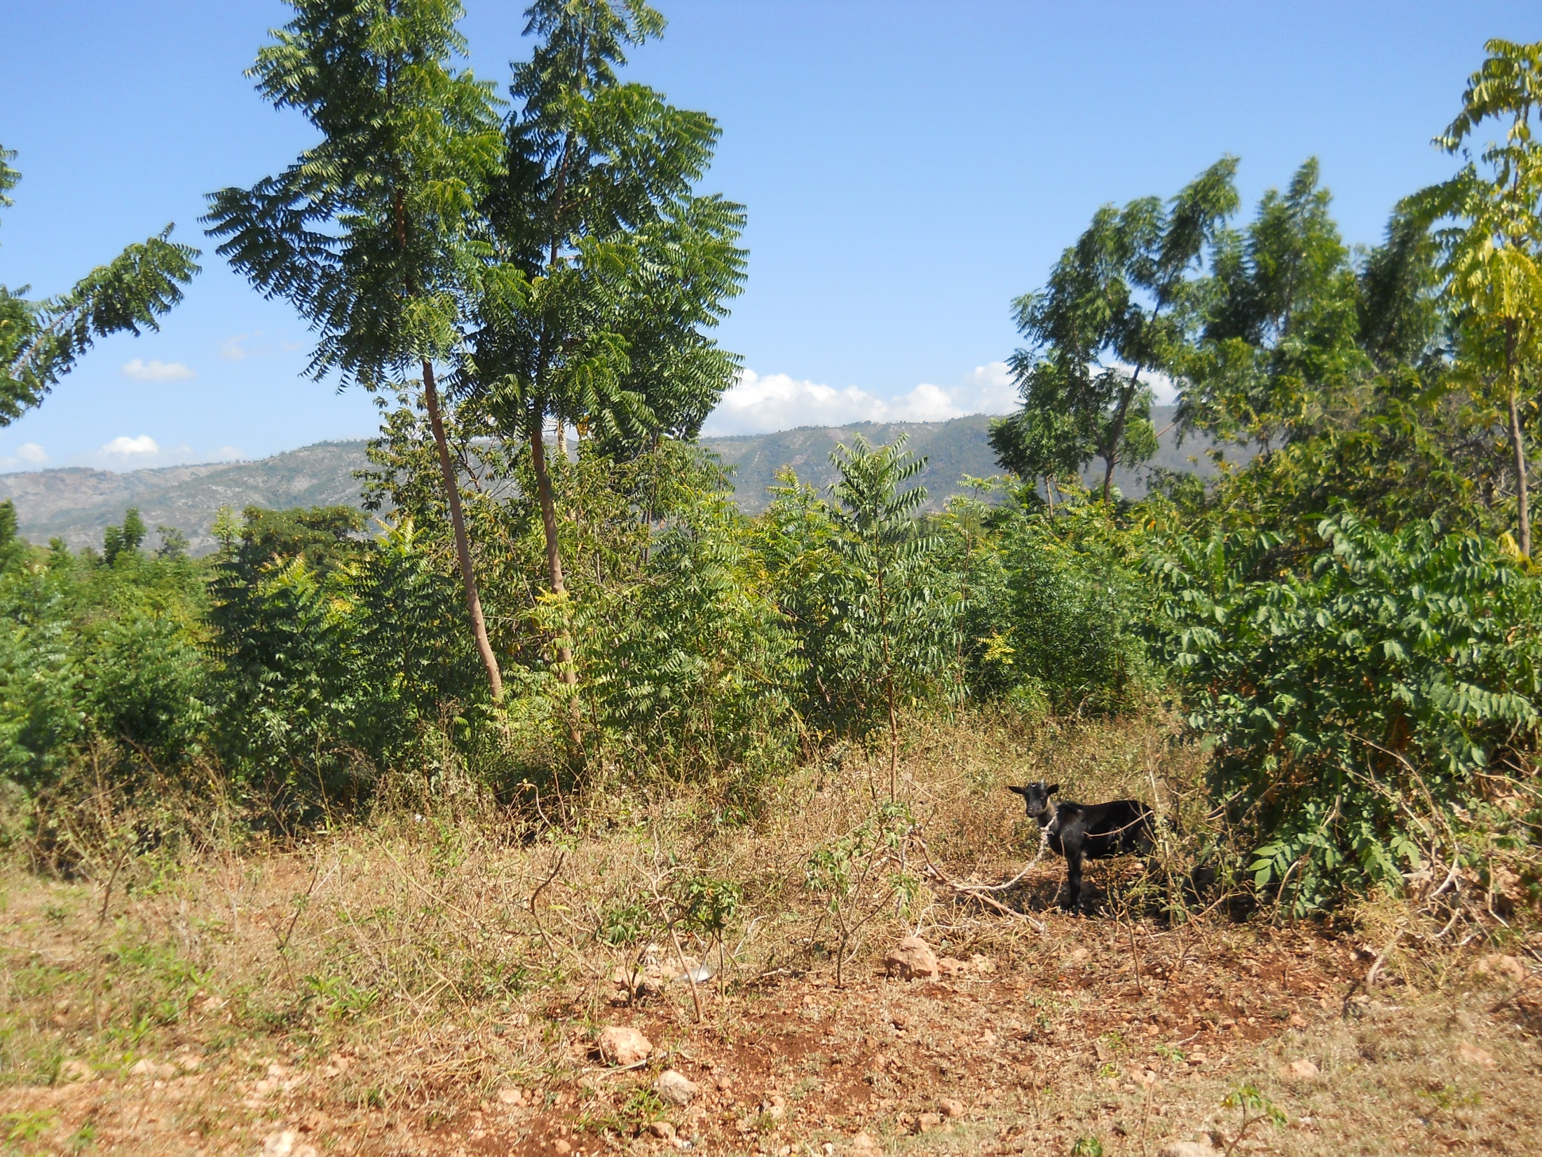

Slide 55
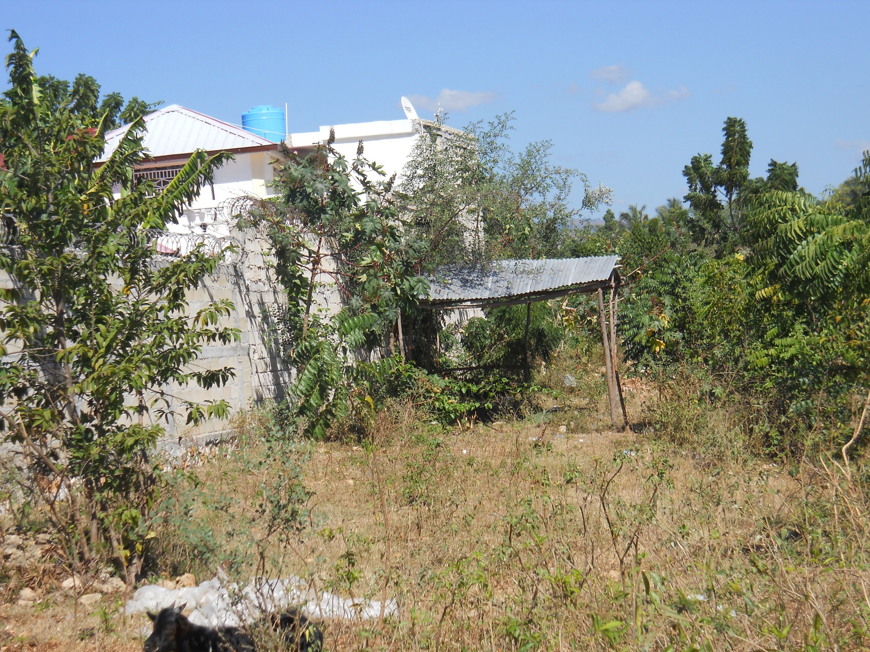

Slide 56
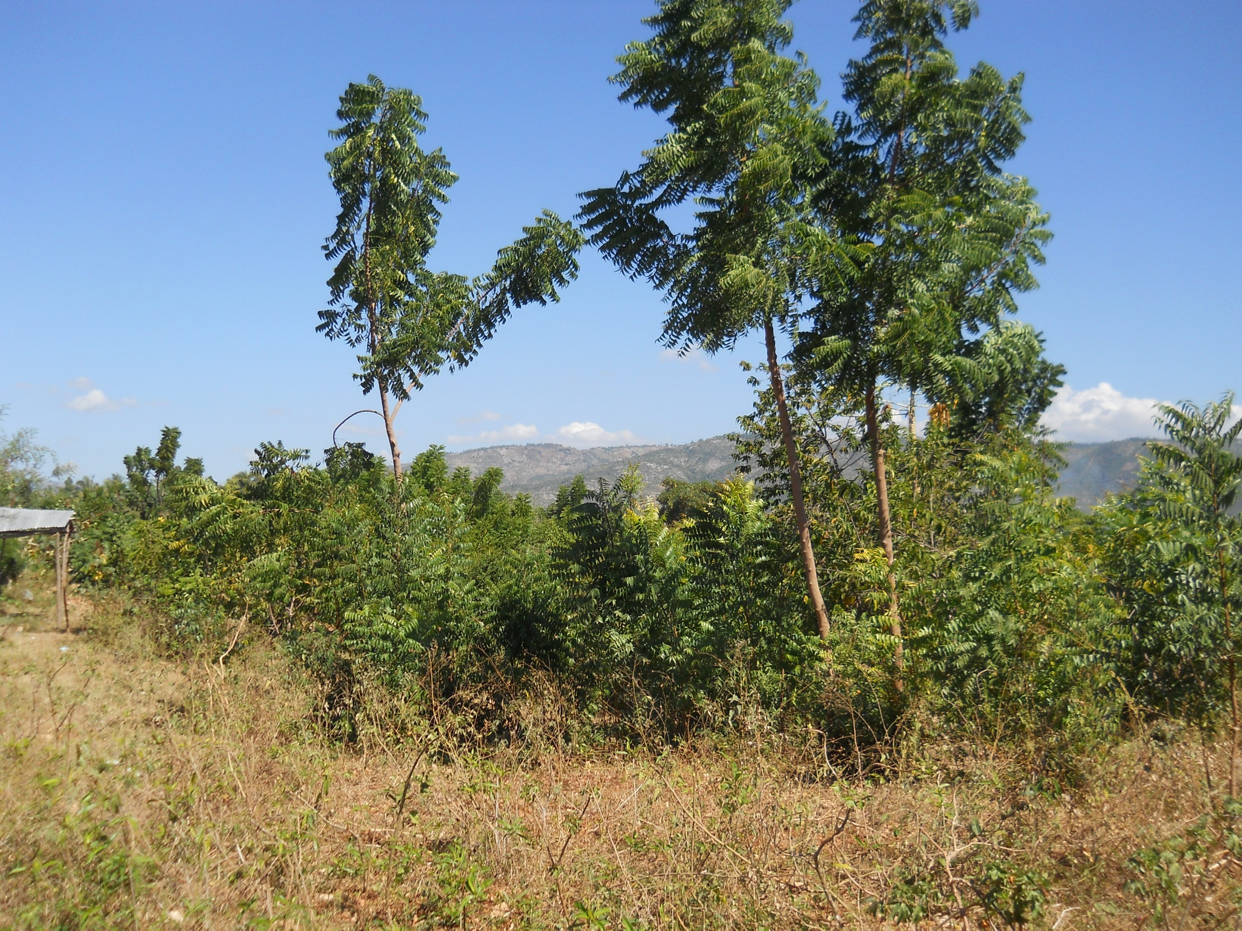

Slide 57
Poverty is everywhere.

Slide 58
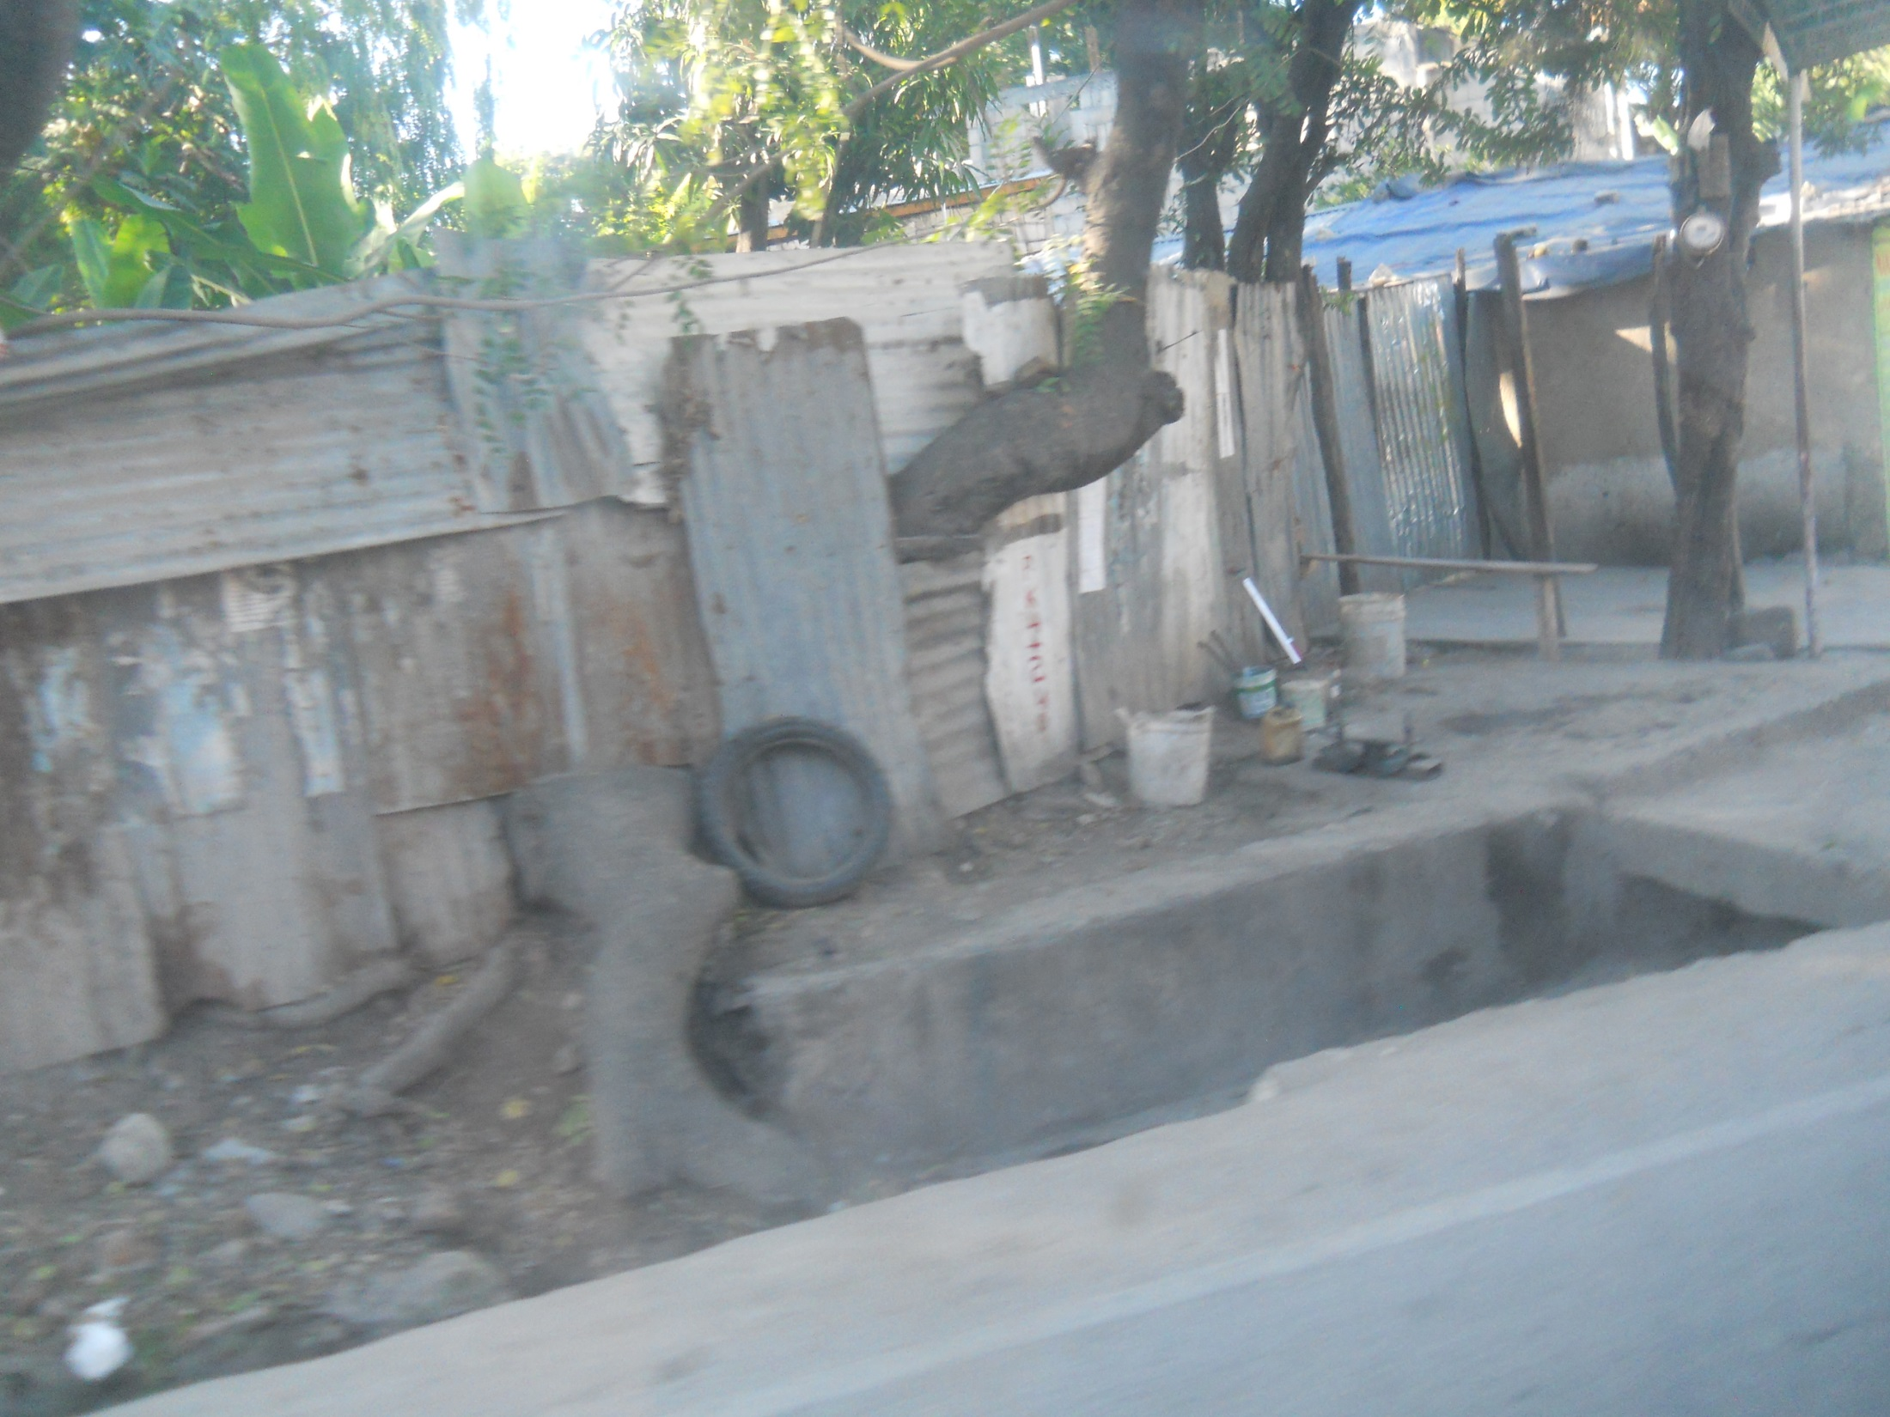

Slide 59
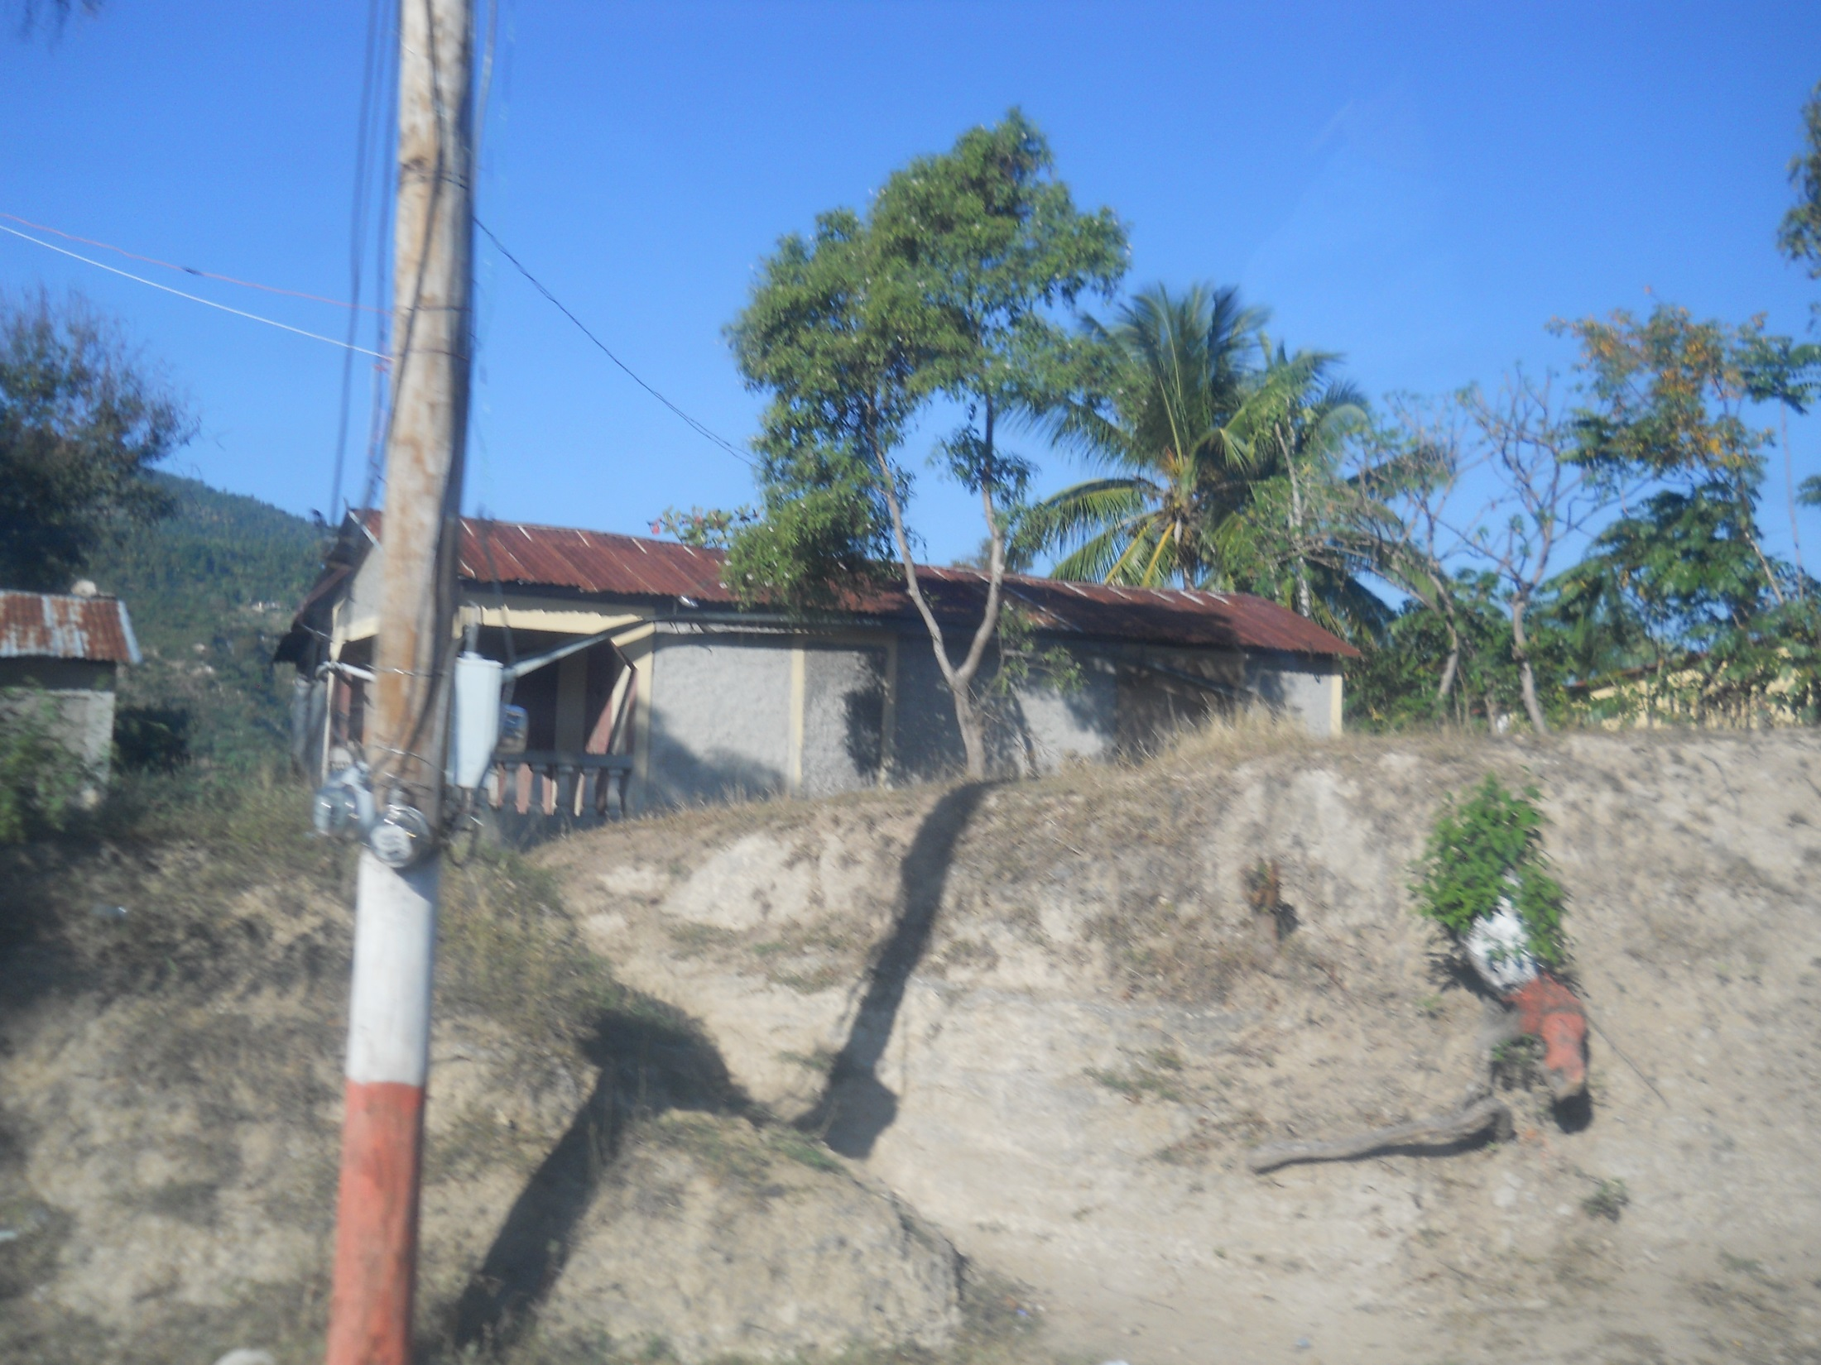

Slide 60
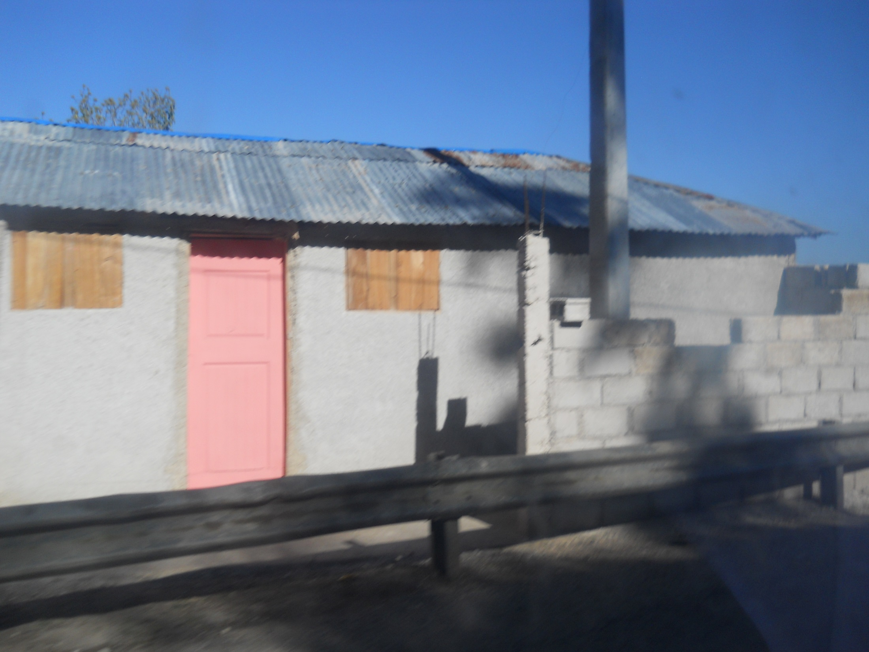

Slide 61
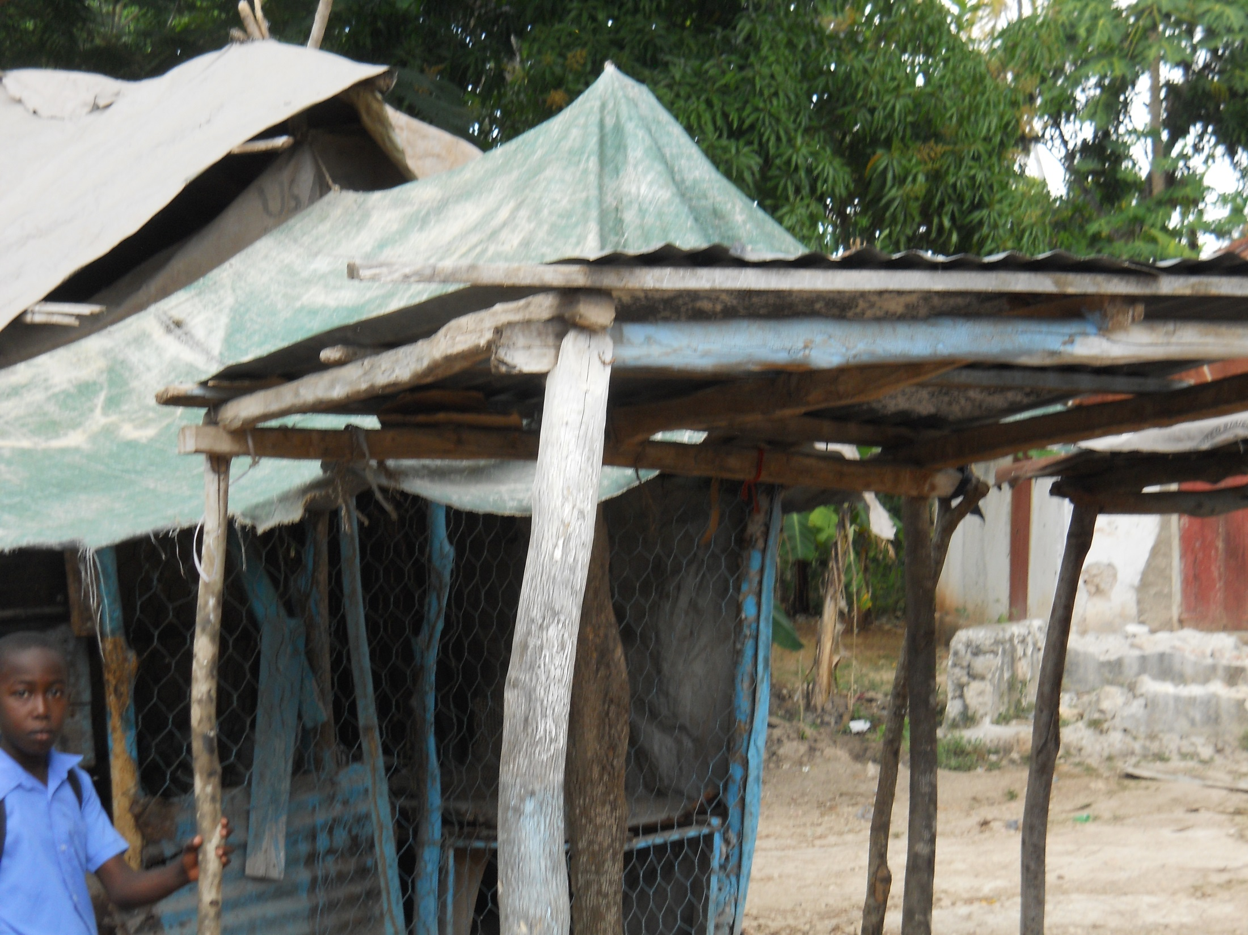

Slide 62
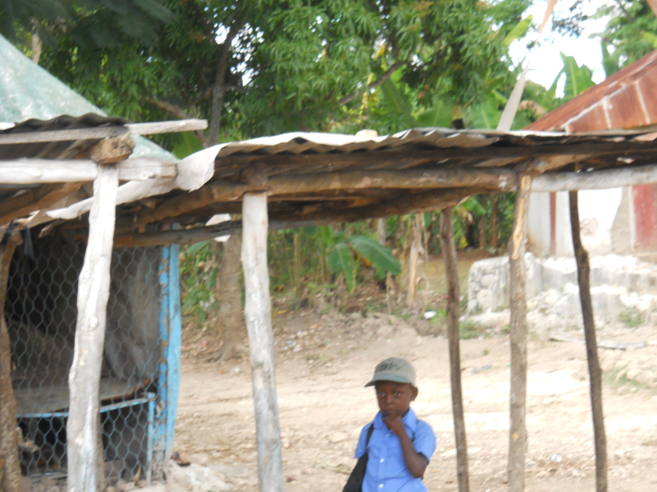

Slide 63
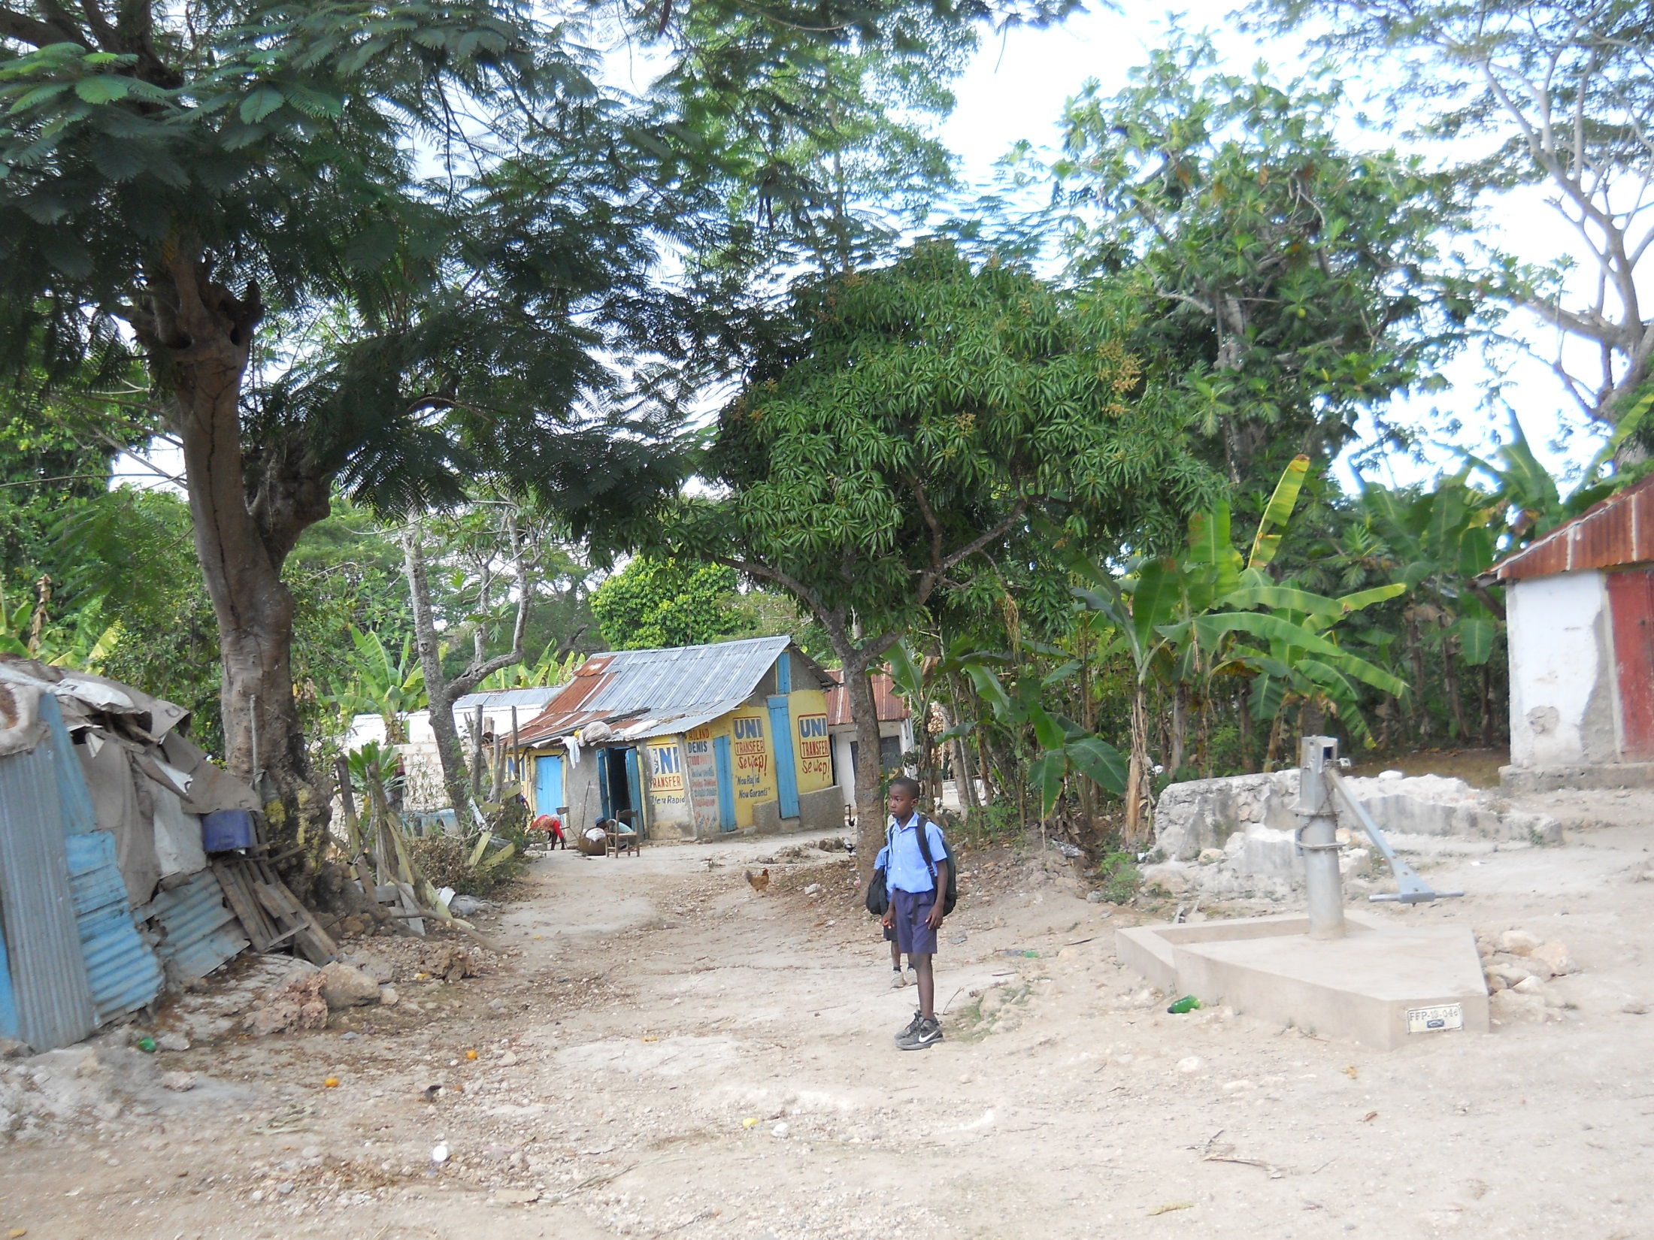

Slide 64
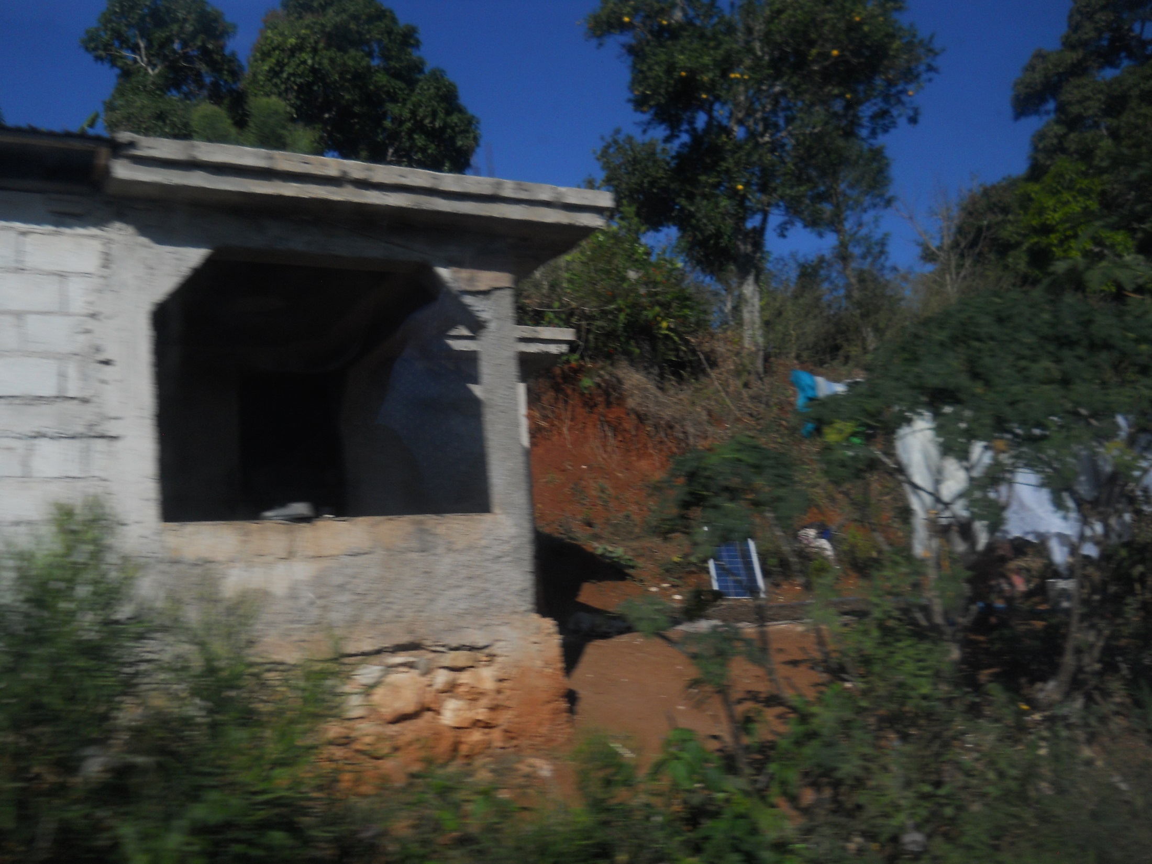

Slide 65
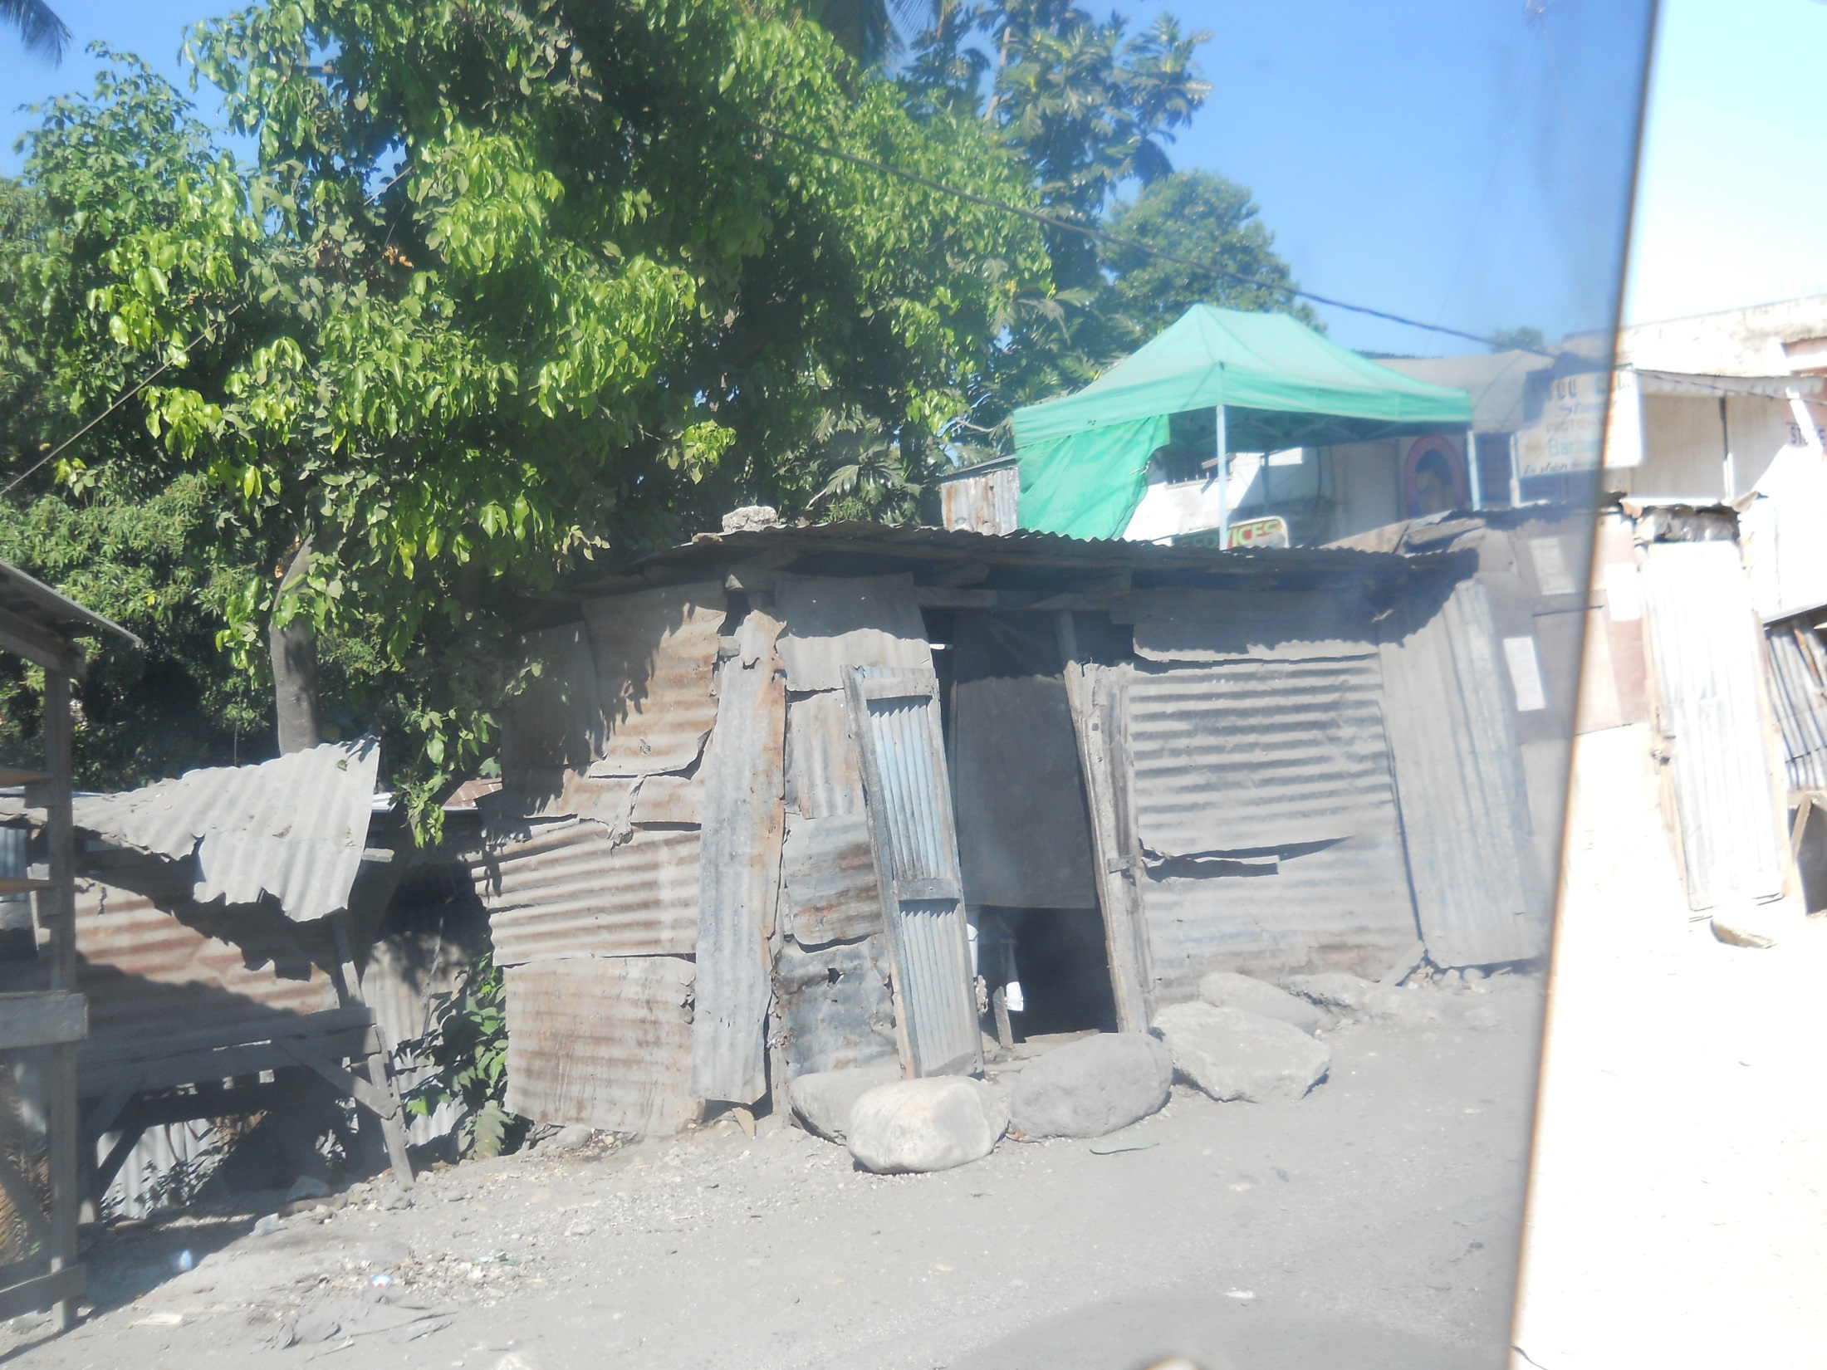

Slide 66
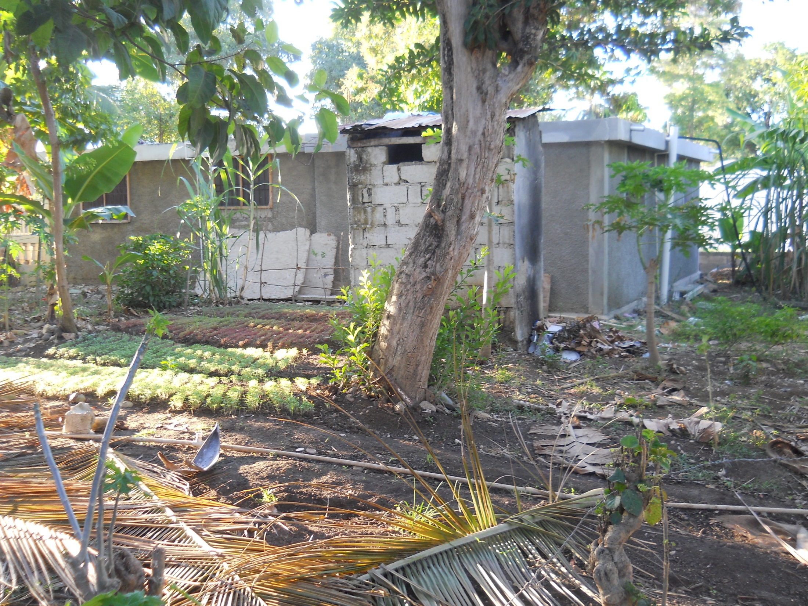

Slide 67
Verily I say unto you, “Inasmuch as ye have done it unto one of the least of these my brethren, ye have done it unto me.”
Matthew 25:40

